Slide 1

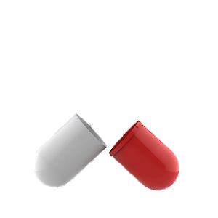

주요 독성 데이터를 활용한 ML 모델 구축 및 평가
2021-08-24
Gwangju Institute of Science and Technology (GIST)
Bioinformatics and Intelligence Lab. (BIIL)
Notes:
Good afternoon, My name is hyunhokim.
Today I am gonna present my personal research status, the title is BayeshERG : Bayesian deep learning framework for predicting hERG blockers.

Slide 2
Table of Contents
Research Background
Introduction
Related studies
Research Introduction
Materials & methods
Datasets
Feature Engineering
Evaluation Metrics
Result & Discussion
In vitro result
Attention Analysis
Future works
Notes:
These are the table of contents. I will start my presentation with research background.
Then, in materials and methods, I will introduce the research overview and explain the analysis methods.
Then, the temporal result will be delivered. Finally, I will end up my presentation with discussions and future works.
After that, the result and discussion will be delivered.
I will end up the presentation with future works.

Slide 3
Research Background

Slide 4
1. Research Background
Introduction
연구과제 보조: 독성 데이터의 수집 및 전처리와 간단한 ML 모델 구축
해당 연구의 필요성 고찰
Notes:
The hERG channel which subunit is Kv11.1 is the voltage gated potassium ion channel. The main role of this channel is regulating cardiac action potential.
When a drug inhibit the hERG channel, it will cause QT interval prolongation and then it will leads fatal cardiac arrhythmia So called Tordase de Pointes.
So if a drug inhibit the hERG channel, it may have severe cardiotoxicity.
Therefore the assessment of hERG inhibition of compounds is essential to reduce the risk in early stage of drug discovery.
Conventionally, in vitro screening is widely-used but it is costly, laborious, and time-consuming method.
Therefore, nowadays, in silico approaches are getting more attention!

Slide 5
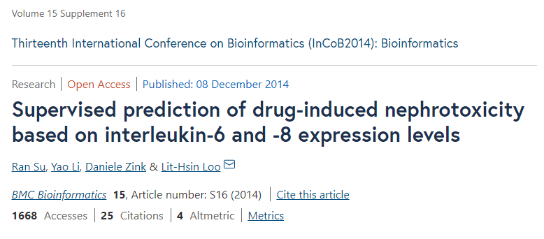
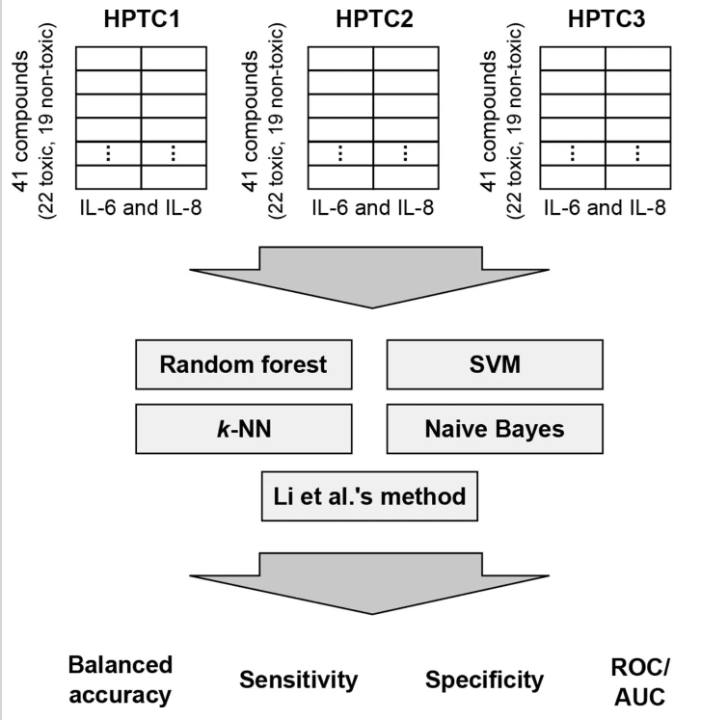
1. Research Background
Related studies
약물 독성에 의한 신체 손상은 신체에 영구적인 타격을 입힐 수 있으며, 신약의 임상시험 시 주된 실패의 원인이 된다.
4종의 Supervised Classifier를 사용
RandomForest, SVM, k-NN, Naïve Bayes
4종의 Classification Evaluation Metric 사용
Balanced Accuracy, Sensitivity, Specificity, ROC/AUC
Cross Validation은 사용되지 않음
평균 Balanced Accuracy는 80.7%
Notes:
The first related study for today is Pred-hERG, which is published in 2015.
.
.
.
As you see they divided the data into three class to make multi-class model.

Slide 6
1. Research Background
Related studies
 | NB | k-NN | SVM | RF
Balanced accuracy (%) | 70.2 | 74.1 | 81.6 | 87.8
Sensitivity (%) | 62.0 | 74.0 | 78.7 | 89.4
Specificity (%) | 78.4 | 74.2 | 84.2 | 85.9
가장 성능이 좋았던 것은 RandomForest Classifier
Number of Trees: 250
그 다음으로 SVM, k-NN, Naïve Bayes 순
SVM: C(10^2), Gamma(10^2)
K-NN: k(3)
Notes:
The first related study for today is Pred-hERG, which is published in 2015.
.
.
.
As you see they divided the data into three class to make multi-class model.

Slide 7
1. Research Background
Related studies
이를 참고하여 Parameter를 설정하였으며,
Random Forest: Tree 개수(100~1000까지 100단위) / 무한 분기
LGBM: Tree 개수(100~1000까지 100단위) / 무한 분기 / learning rate: 0.1, 0.05, 0.01
Logisitc Regression: Cost Function을 기본값인 1에서 2배씩 늘려가며 128까지 반복
SVM: C를 1, 10, 100, 그리고 gamma를 0.01, 0.001, 0.0001으로 변경해 가며 9회 반복
K-NN: k를 3, 5, 7로 반복 (동률 배제하기 위해 홀수로 지정)
Normalization, OverSampling 등의 기법을 추가로 이용하여 전, 후 평가 진행
Normalization: Min-Max-Scaling
OverSampling: SMOTE
Notes:
The first related study for today is Pred-hERG, which is published in 2015.
.
.
.
As you see they divided the data into three class to make multi-class model.

Slide 8
1. Research Background
Research Introduction
4종 독성 (DILI, Acute Oral Toxicity, AMES Mutagenicity, hERG)
DILI, AMES Mutagenicity, hERG는 Binary Classification
Acute Oral Toxicity의 경우 Multi-class Classification과 Regression
5종 ML 모델 (LogisticRegression, LGBMClassifier, RandomForest, SVM, k-NN)
LogisticRegression
LGBMClassifier
RandomForest
SVM
K-NN
DILI
AOT
AMES
hERG
Notes:
So Now, these are my research objectives.
I am trying to construct Robust, Reliable and Interpretable hERG blocker prediction model.
Because, there is no hERG prediction models which achieves these characteristics so far even though the predicting hERG blockers is key part in drug discovery process.
To achieve the robustness, I utilize the transfer learning to give generalizability to the molecular representation for hERG prediction
Reliability, I employ the Bayesian NNs to provide calibrated results.
Interpretability, I plug in the self-attention mechanism to suggest the hERG-related substructures.

Slide 9
Materials and Method
Notes:
For now, I will introduce materials and method.

Slide 10
2. Materials and Method
Datasets
DILI
Source | DILI Positive | DILI Negative | Total
Ma et al, 2020 | 197 | 282 | 479
DILIst | 768 | 511 | 1,279
Kotsampasakou et al, 2017 | 398 | 413 | 811
Williams et al, 2019 | 44 | 21 | 65
Kim et al, 2017 | 197 | 280 | 477
Zhang et al, 2016 | 785 | 532 | 1,317
Total | 1,212 | 1,014 | 2,226
Notes:
This is the Research overview.
My research consists of 4 steps.
First step is data preparation step. I collected the hERG related big-data from public databases and literatures and pre-processed in to two sets.
One is pretraining set which contains hERG inhibition % at 10uM data and the other is fine-tuning set which contains the IC50-derived hERG inhibition data.
Second step is model construction step. First, I trained the proposed Bayesian GNN with pre-training set. Then, the weights are transferred to train the fine-tuning set.
I used MC-dropout to approximate the BNN, so in pre-training step, I got the optimized weights with point estimation with just simple dropout.
And in fine-tuning step, with transferred weights, I make model which learns the posterior distribution of model parameters.
Third step is Model validation step. I conducted internal and external validation, and also in vitro validation.
The last step is result analysis step. In this part, the calibration and uncertainty analysis and attention analysis are conducted.
Today, I will skip the first two steps and some part of model validation step and result analysis step which are already covered in the previous seminar.
I will focus on the in vitro validation and attention analysis.

Slide 11
2. Materials and Method
Datasets
2) Acute Oral Toxicity (Rat)
Source | Category | # | class 1 | class 2 | class 3 | class 4 | class 5
Gadaleta et al, 2019 | LD50_minLog | 8,309 | - | - | - | - | -
 | EPA_cateogry | 11,744 | 980 | 2,632 | 5,861 | 2,271 | -
 | GHS_category | 11,834 | 228 | 752 | 1,597 | 4,175 | 5,082
Notes:
This is the Research overview.
My research consists of 4 steps.
First step is data preparation step. I collected the hERG related big-data from public databases and literatures and pre-processed in to two sets.
One is pretraining set which contains hERG inhibition % at 10uM data and the other is fine-tuning set which contains the IC50-derived hERG inhibition data.
Second step is model construction step. First, I trained the proposed Bayesian GNN with pre-training set. Then, the weights are transferred to train the fine-tuning set.
I used MC-dropout to approximate the BNN, so in pre-training step, I got the optimized weights with point estimation with just simple dropout.
And in fine-tuning step, with transferred weights, I make model which learns the posterior distribution of model parameters.
Third step is Model validation step. I conducted internal and external validation, and also in vitro validation.
The last step is result analysis step. In this part, the calibration and uncertainty analysis and attention analysis are conducted.
Today, I will skip the first two steps and some part of model validation step and result analysis step which are already covered in the previous seminar.
I will focus on the in vitro validation and attention analysis.

Slide 12
2. Materials and Method
Datasets
3) AMES Mutagenicity
Source | AMES Positive | AMES Negative | Total
Hansen et al, 2009 | 3,503 | 3,009 | 6,512
Li et al, 2021 | 703 | 680 | 1,383
NIHS | 672 | - | 672
Xu et al, 2012 | 4,866 | 3,482 | 8,348
Total | 4,828 | 3,792 | 8,620
Notes:
This is the Research overview.
My research consists of 4 steps.
First step is data preparation step. I collected the hERG related big-data from public databases and literatures and pre-processed in to two sets.
One is pretraining set which contains hERG inhibition % at 10uM data and the other is fine-tuning set which contains the IC50-derived hERG inhibition data.
Second step is model construction step. First, I trained the proposed Bayesian GNN with pre-training set. Then, the weights are transferred to train the fine-tuning set.
I used MC-dropout to approximate the BNN, so in pre-training step, I got the optimized weights with point estimation with just simple dropout.
And in fine-tuning step, with transferred weights, I make model which learns the posterior distribution of model parameters.
Third step is Model validation step. I conducted internal and external validation, and also in vitro validation.
The last step is result analysis step. In this part, the calibration and uncertainty analysis and attention analysis are conducted.
Today, I will skip the first two steps and some part of model validation step and result analysis step which are already covered in the previous seminar.
I will focus on the in vitro validation and attention analysis.

Slide 13
2. Materials and Method
Datasets
4) hERG
Source | hERG Positive | hERG Negative | Total
BindingDB | 633 | 290 | 923
ChEMBL | 3,954 | 1,741 | 5,695
PubChem | 2,205 | 1,922 | 4,127
Cai et al, 2019 | 3,485 | 2,826 | 6,311
Total | 8,112 | 5,789 | 13,901
Notes:
This is the Research overview.
My research consists of 4 steps.
First step is data preparation step. I collected the hERG related big-data from public databases and literatures and pre-processed in to two sets.
One is pretraining set which contains hERG inhibition % at 10uM data and the other is fine-tuning set which contains the IC50-derived hERG inhibition data.
Second step is model construction step. First, I trained the proposed Bayesian GNN with pre-training set. Then, the weights are transferred to train the fine-tuning set.
I used MC-dropout to approximate the BNN, so in pre-training step, I got the optimized weights with point estimation with just simple dropout.
And in fine-tuning step, with transferred weights, I make model which learns the posterior distribution of model parameters.
Third step is Model validation step. I conducted internal and external validation, and also in vitro validation.
The last step is result analysis step. In this part, the calibration and uncertainty analysis and attention analysis are conducted.
Today, I will skip the first two steps and some part of model validation step and result analysis step which are already covered in the previous seminar.
I will focus on the in vitro validation and attention analysis.

Slide 14
2. Materials and Method
Feature Engineering
Model-Free: Standard Deviation 확인
Categorical 변수와 Continuous 변수 분리
Categorical은 전반적인 분포를 확인하여 과한 쏠림 현상을 보이는 경우 제거
Continuous는 Standard Deviation을 확인
적절한 개수로 줄어들도록 threshold 설정
Data | threshold | # of Descriptors
DILI | 0.06 | 138 (-70)
Acute Oral Toxicity: LD50 | 0.05 | 143 (-65)
Acute Oral Toxicity: EPA | 0.03 | 145 (-63)
Acute Oral Toxicity: GHS | 0.03 | 145 (-63)
AMES Mutagenicity | 0.035 | 143 (-65)
hERG | 0.07 | 145 (-63)
Notes:
In this study, the in vitro validation was performed. the objective of the experiment is to find whether the predicted strong positives are reliable.
So I selected the experimental compounds in KCB data, I will explain the process step by step.
First, I found the compounds which are predicted as hERG positive with an extremely high probability by both BayeshERGs.
Second, I filter out the compounds which are predicted as positive by comparative models, DeepHIT and Pred-hERG.
Third, I filtered out again the compounds which have similar descriptor patterns with training set. I conducted z-test to the statistically significant Rdkit descriptors.

Slide 15
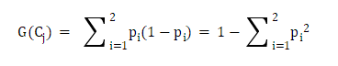
2. Materials and Method
Feature Engineering
2) Model-Based: RandomForest 이용하여 Feature importance 확인
- Binary Classification: DILI, AMES Mutagenicity, hERG
Notes:
In this study, the in vitro validation was performed. the objective of the experiment is to find whether the predicted strong positives are reliable.
So I selected the experimental compounds in KCB data, I will explain the process step by step.
First, I found the compounds which are predicted as hERG positive with an extremely high probability by both BayeshERGs.
Second, I filter out the compounds which are predicted as positive by comparative models, DeepHIT and Pred-hERG.
Third, I filtered out again the compounds which have similar descriptor patterns with training set. I conducted z-test to the statistically significant Rdkit descriptors.

Slide 16
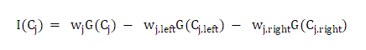
2. Materials and Method
Feature Engineering
2) Model-Based: RandomForest 이용하여 Feature importance 확인
- Binary Classification: DILI, AMES Mutagenicity, hERG
Notes:
In this study, the in vitro validation was performed. the objective of the experiment is to find whether the predicted strong positives are reliable.
So I selected the experimental compounds in KCB data, I will explain the process step by step.
First, I found the compounds which are predicted as hERG positive with an extremely high probability by both BayeshERGs.
Second, I filter out the compounds which are predicted as positive by comparative models, DeepHIT and Pred-hERG.
Third, I filtered out again the compounds which have similar descriptor patterns with training set. I conducted z-test to the statistically significant Rdkit descriptors.

Slide 17
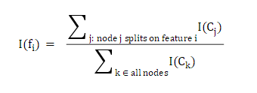
2. Materials and Method
Feature Engineering
2) Model-Based: RandomForest 이용하여 Feature importance 확인
- Binary Classification: DILI, AMES Mutagenicity, hERG
Notes:
In this study, the in vitro validation was performed. the objective of the experiment is to find whether the predicted strong positives are reliable.
So I selected the experimental compounds in KCB data, I will explain the process step by step.
First, I found the compounds which are predicted as hERG positive with an extremely high probability by both BayeshERGs.
Second, I filter out the compounds which are predicted as positive by comparative models, DeepHIT and Pred-hERG.
Third, I filtered out again the compounds which have similar descriptor patterns with training set. I conducted z-test to the statistically significant Rdkit descriptors.

Slide 18
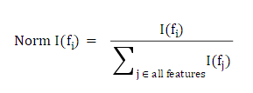
2. Materials and Method
Feature Engineering
2) Model-Based: RandomForest 이용하여 Feature importance 확인
- Binary Classification: DILI, AMES Mutagenicity, hERG
Notes:
In this study, the in vitro validation was performed. the objective of the experiment is to find whether the predicted strong positives are reliable.
So I selected the experimental compounds in KCB data, I will explain the process step by step.
First, I found the compounds which are predicted as hERG positive with an extremely high probability by both BayeshERGs.
Second, I filter out the compounds which are predicted as positive by comparative models, DeepHIT and Pred-hERG.
Third, I filtered out again the compounds which have similar descriptor patterns with training set. I conducted z-test to the statistically significant Rdkit descriptors.

Slide 19
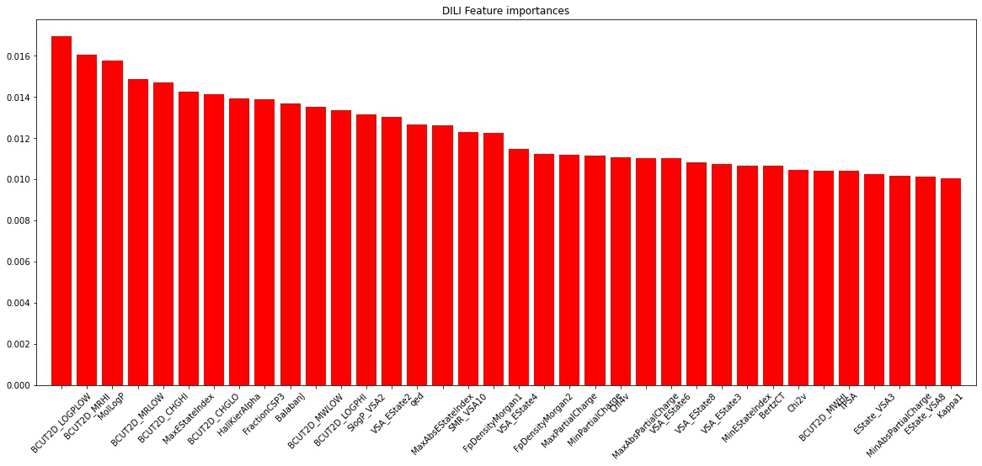
2. Materials and Method
Feature Engineering
- DILI
Notes:
In this study, the in vitro validation was performed. the objective of the experiment is to find whether the predicted strong positives are reliable.
So I selected the experimental compounds in KCB data, I will explain the process step by step.
First, I found the compounds which are predicted as hERG positive with an extremely high probability by both BayeshERGs.
Second, I filter out the compounds which are predicted as positive by comparative models, DeepHIT and Pred-hERG.
Third, I filtered out again the compounds which have similar descriptor patterns with training set. I conducted z-test to the statistically significant Rdkit descriptors.

Slide 20
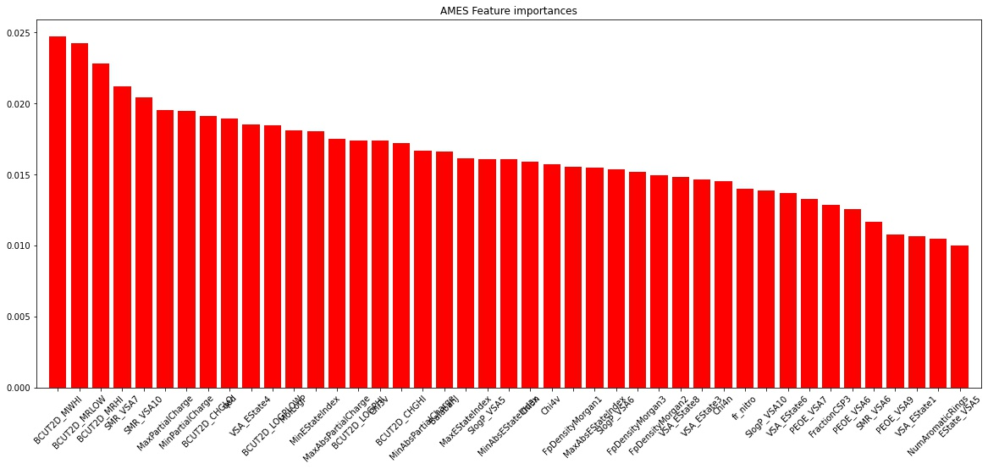
2. Materials and Method
Feature Engineering
- AMES Mutagenicity
Notes:
In this study, the in vitro validation was performed. the objective of the experiment is to find whether the predicted strong positives are reliable.
So I selected the experimental compounds in KCB data, I will explain the process step by step.
First, I found the compounds which are predicted as hERG positive with an extremely high probability by both BayeshERGs.
Second, I filter out the compounds which are predicted as positive by comparative models, DeepHIT and Pred-hERG.
Third, I filtered out again the compounds which have similar descriptor patterns with training set. I conducted z-test to the statistically significant Rdkit descriptors.

Slide 21
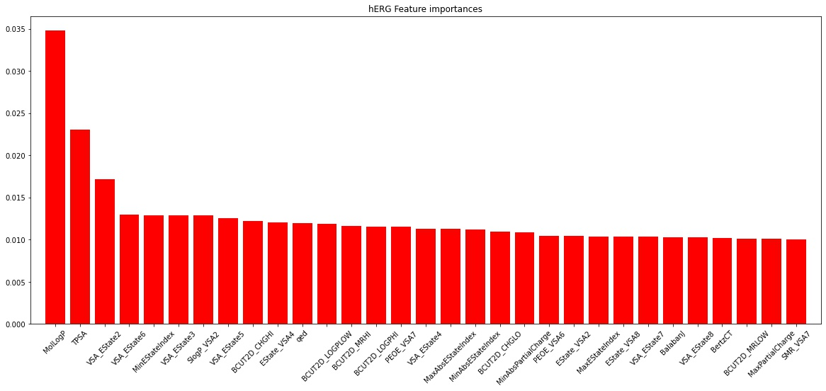
2. Materials and Method
Feature Engineering
- hERG
Notes:
In this study, the in vitro validation was performed. the objective of the experiment is to find whether the predicted strong positives are reliable.
So I selected the experimental compounds in KCB data, I will explain the process step by step.
First, I found the compounds which are predicted as hERG positive with an extremely high probability by both BayeshERGs.
Second, I filter out the compounds which are predicted as positive by comparative models, DeepHIT and Pred-hERG.
Third, I filtered out again the compounds which have similar descriptor patterns with training set. I conducted z-test to the statistically significant Rdkit descriptors.

Slide 22
2. Materials and Method
Feature Engineering
2) Model-Based: RandomForest 이용하여 Feature importance 확인
- Multi-Class Classification: Acute Oral Toxicity (EPA, GHS)
Notes:
In this study, the in vitro validation was performed. the objective of the experiment is to find whether the predicted strong positives are reliable.
So I selected the experimental compounds in KCB data, I will explain the process step by step.
First, I found the compounds which are predicted as hERG positive with an extremely high probability by both BayeshERGs.
Second, I filter out the compounds which are predicted as positive by comparative models, DeepHIT and Pred-hERG.
Third, I filtered out again the compounds which have similar descriptor patterns with training set. I conducted z-test to the statistically significant Rdkit descriptors.

Slide 23
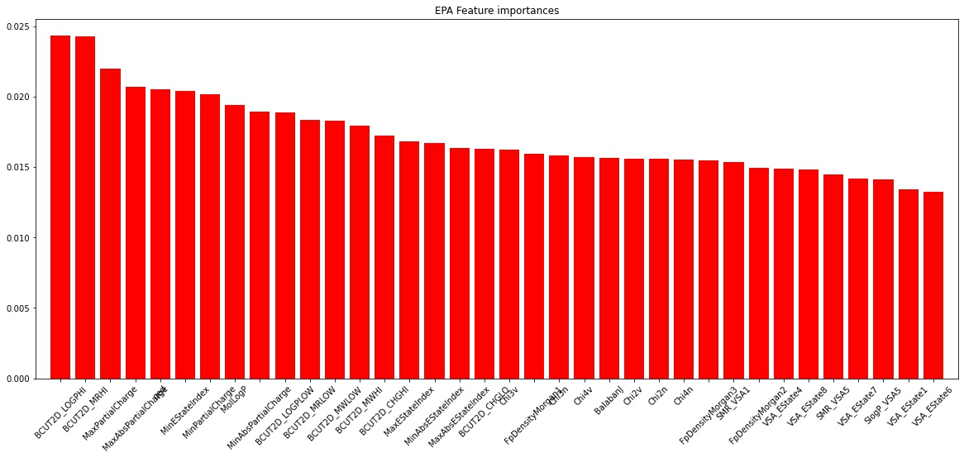
2. Materials and Method
Feature Engineering
- Acute Oral Toxicity(EPA_category)
Notes:
In this study, the in vitro validation was performed. the objective of the experiment is to find whether the predicted strong positives are reliable.
So I selected the experimental compounds in KCB data, I will explain the process step by step.
First, I found the compounds which are predicted as hERG positive with an extremely high probability by both BayeshERGs.
Second, I filter out the compounds which are predicted as positive by comparative models, DeepHIT and Pred-hERG.
Third, I filtered out again the compounds which have similar descriptor patterns with training set. I conducted z-test to the statistically significant Rdkit descriptors.

Slide 24
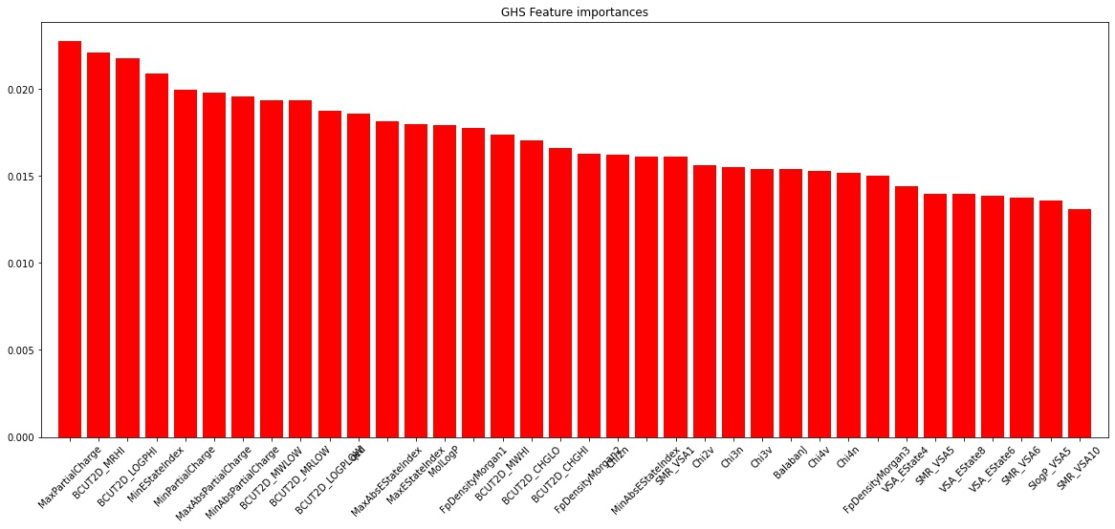
2. Materials and Method
Feature Engineering
- Acute Oral Toxicity(GHS_category)
Notes:
In this study, the in vitro validation was performed. the objective of the experiment is to find whether the predicted strong positives are reliable.
So I selected the experimental compounds in KCB data, I will explain the process step by step.
First, I found the compounds which are predicted as hERG positive with an extremely high probability by both BayeshERGs.
Second, I filter out the compounds which are predicted as positive by comparative models, DeepHIT and Pred-hERG.
Third, I filtered out again the compounds which have similar descriptor patterns with training set. I conducted z-test to the statistically significant Rdkit descriptors.

Slide 25
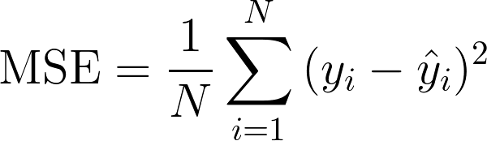
2. Materials and Method
Feature Engineering
2) Model-Based: RandomForest 이용하여 Feature importance 확인
- Regression: Acute Oral Toxicity(LD50)
Notes:
In this study, the in vitro validation was performed. the objective of the experiment is to find whether the predicted strong positives are reliable.
So I selected the experimental compounds in KCB data, I will explain the process step by step.
First, I found the compounds which are predicted as hERG positive with an extremely high probability by both BayeshERGs.
Second, I filter out the compounds which are predicted as positive by comparative models, DeepHIT and Pred-hERG.
Third, I filtered out again the compounds which have similar descriptor patterns with training set. I conducted z-test to the statistically significant Rdkit descriptors.

Slide 26
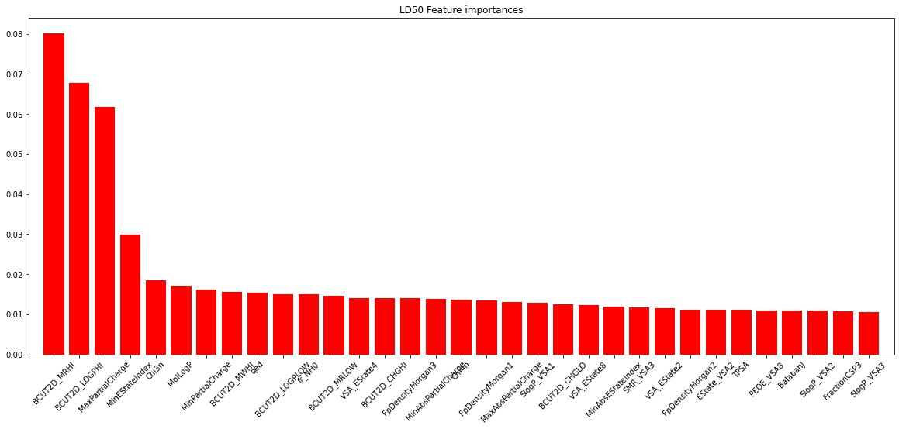
2. Materials and Method
Feature Engineering
- Acute Oral Toxicity(LD50)
Notes:
In this study, the in vitro validation was performed. the objective of the experiment is to find whether the predicted strong positives are reliable.
So I selected the experimental compounds in KCB data, I will explain the process step by step.
First, I found the compounds which are predicted as hERG positive with an extremely high probability by both BayeshERGs.
Second, I filter out the compounds which are predicted as positive by comparative models, DeepHIT and Pred-hERG.
Third, I filtered out again the compounds which have similar descriptor patterns with training set. I conducted z-test to the statistically significant Rdkit descriptors.

Slide 27
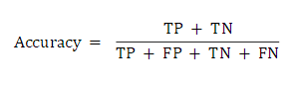
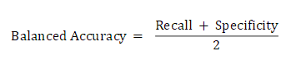
2. Materials and Method
Evaluation Metrics
1) Accuracy
2) Balanced Accuracy
Notes:
In this study, the in vitro validation was performed. the objective of the experiment is to find whether the predicted strong positives are reliable.
So I selected the experimental compounds in KCB data, I will explain the process step by step.
First, I found the compounds which are predicted as hERG positive with an extremely high probability by both BayeshERGs.
Second, I filter out the compounds which are predicted as positive by comparative models, DeepHIT and Pred-hERG.
Third, I filtered out again the compounds which have similar descriptor patterns with training set. I conducted z-test to the statistically significant Rdkit descriptors.

Slide 28
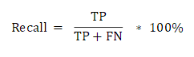
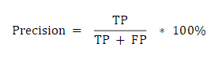
2. Materials and Method
Evaluation Metrics
3) Recall
4) Precision
Notes:
In this study, the in vitro validation was performed. the objective of the experiment is to find whether the predicted strong positives are reliable.
So I selected the experimental compounds in KCB data, I will explain the process step by step.
First, I found the compounds which are predicted as hERG positive with an extremely high probability by both BayeshERGs.
Second, I filter out the compounds which are predicted as positive by comparative models, DeepHIT and Pred-hERG.
Third, I filtered out again the compounds which have similar descriptor patterns with training set. I conducted z-test to the statistically significant Rdkit descriptors.

Slide 29
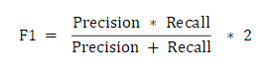
2. Materials and Method
Evaluation Metrics
5) F1
Notes:
In this study, the in vitro validation was performed. the objective of the experiment is to find whether the predicted strong positives are reliable.
So I selected the experimental compounds in KCB data, I will explain the process step by step.
First, I found the compounds which are predicted as hERG positive with an extremely high probability by both BayeshERGs.
Second, I filter out the compounds which are predicted as positive by comparative models, DeepHIT and Pred-hERG.
Third, I filtered out again the compounds which have similar descriptor patterns with training set. I conducted z-test to the statistically significant Rdkit descriptors.

Slide 30
Results & Discussion
Notes:
So now the result will be followed.

Slide 31
3. Results & Discussion
DILI
Notes:
Total 14 compounds are selected from KCB library by rigorous selection criteria.
Among them, 12 compounds are experimentally validated because two compounds were unavailable in KCB.
Among them, 4 compounds were hERG inhibitors. 3 were moderate, and 1 was strong.
In this experiment, the hit rate is 33% which is significantly larger than reported random hit rate.
We can conclude that BayeshERG showed robust performance since it showed high hit rate even though the selected compounds are not easy to classify.

Slide 32
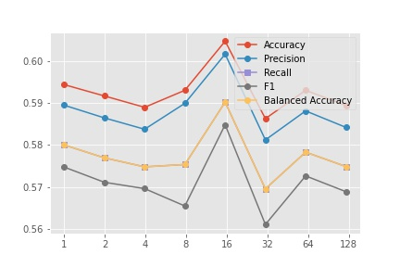
3. Results & Discussion
Logistic Regression
특별한 처리를 해주지 않았을 때의 성능
>> C가 16일 때, 모든 점수가 가장 높았고, 이후 감소하는 경향
Notes:
Total 14 compounds are selected from KCB library by rigorous selection criteria.
Among them, 12 compounds are experimentally validated because two compounds were unavailable in KCB.
Among them, 4 compounds were hERG inhibitors. 3 were moderate, and 1 was strong.
In this experiment, the hit rate is 33% which is significantly larger than reported random hit rate.
We can conclude that BayeshERG showed robust performance since it showed high hit rate even though the selected compounds are not easy to classify.

Slide 33
3. Results & Discussion
Logistic Regression + Scaling
MinMaxScaler를 이용한 Scaling 진행
>> C와 반비례하게 전반적인 성능이 감소
Notes:
Total 14 compounds are selected from KCB library by rigorous selection criteria.
Among them, 12 compounds are experimentally validated because two compounds were unavailable in KCB.
Among them, 4 compounds were hERG inhibitors. 3 were moderate, and 1 was strong.
In this experiment, the hit rate is 33% which is significantly larger than reported random hit rate.
We can conclude that BayeshERG showed robust performance since it showed high hit rate even though the selected compounds are not easy to classify.

Slide 34
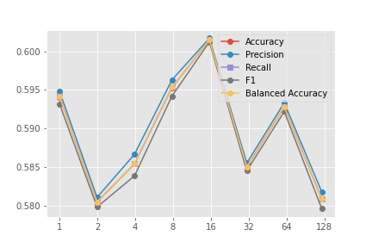
3. Results & Discussion
Logistic Regression + SMOTE
Scaling 이후 SMOTE를 이용한 Oversampling
>> 전반적인 성능 향상 / C가 2일 때 최대
Notes:
Total 14 compounds are selected from KCB library by rigorous selection criteria.
Among them, 12 compounds are experimentally validated because two compounds were unavailable in KCB.
Among them, 4 compounds were hERG inhibitors. 3 were moderate, and 1 was strong.
In this experiment, the hit rate is 33% which is significantly larger than reported random hit rate.
We can conclude that BayeshERG showed robust performance since it showed high hit rate even though the selected compounds are not easy to classify.

Slide 35
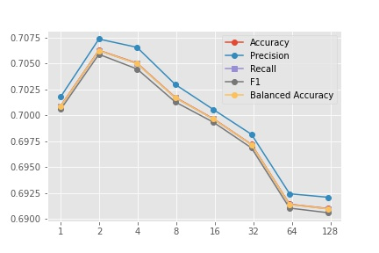
3. Results & Discussion
Logistic Regression + Scaling + SMOTE
Scaling 이후 SMOTE를 이용한 Oversampling
>> 전반적인 성능 향상 / C가 2일 때 최대
Notes:
Total 14 compounds are selected from KCB library by rigorous selection criteria.
Among them, 12 compounds are experimentally validated because two compounds were unavailable in KCB.
Among them, 4 compounds were hERG inhibitors. 3 were moderate, and 1 was strong.
In this experiment, the hit rate is 33% which is significantly larger than reported random hit rate.
We can conclude that BayeshERG showed robust performance since it showed high hit rate even though the selected compounds are not easy to classify.

Slide 36
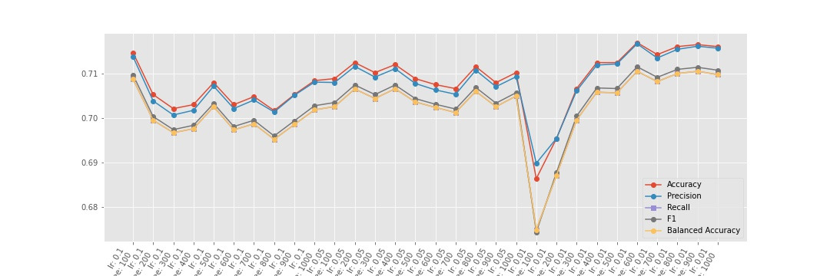
3. Results & Discussion
LGBMClassifier
특별한 처리를 해주지 않았을 때의 성능
>> C가 16일 때, 모든 점수가 가장 높았고, 이후 감소하는 경향
Notes:
Total 14 compounds are selected from KCB library by rigorous selection criteria.
Among them, 12 compounds are experimentally validated because two compounds were unavailable in KCB.
Among them, 4 compounds were hERG inhibitors. 3 were moderate, and 1 was strong.
In this experiment, the hit rate is 33% which is significantly larger than reported random hit rate.
We can conclude that BayeshERG showed robust performance since it showed high hit rate even though the selected compounds are not easy to classify.

Slide 37
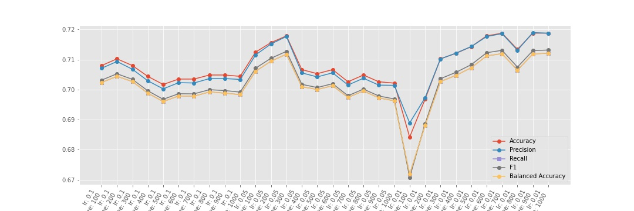
3. Results & Discussion
LGBMClassifier + Scaling
MinMaxScaler를 이용한 Scaling 진행
>> C와 반비례하게 전반적인 성능이 감소
Notes:
Total 14 compounds are selected from KCB library by rigorous selection criteria.
Among them, 12 compounds are experimentally validated because two compounds were unavailable in KCB.
Among them, 4 compounds were hERG inhibitors. 3 were moderate, and 1 was strong.
In this experiment, the hit rate is 33% which is significantly larger than reported random hit rate.
We can conclude that BayeshERG showed robust performance since it showed high hit rate even though the selected compounds are not easy to classify.

Slide 38
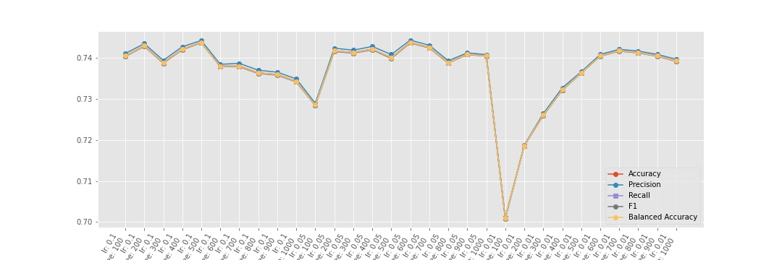
3. Results & Discussion
LGBMClassifier + SMOTE
Scaling 이후 SMOTE를 이용한 Oversampling
>> 전반적인 성능 향상 / C가 2일 때 최대
Notes:
Total 14 compounds are selected from KCB library by rigorous selection criteria.
Among them, 12 compounds are experimentally validated because two compounds were unavailable in KCB.
Among them, 4 compounds were hERG inhibitors. 3 were moderate, and 1 was strong.
In this experiment, the hit rate is 33% which is significantly larger than reported random hit rate.
We can conclude that BayeshERG showed robust performance since it showed high hit rate even though the selected compounds are not easy to classify.

Slide 39
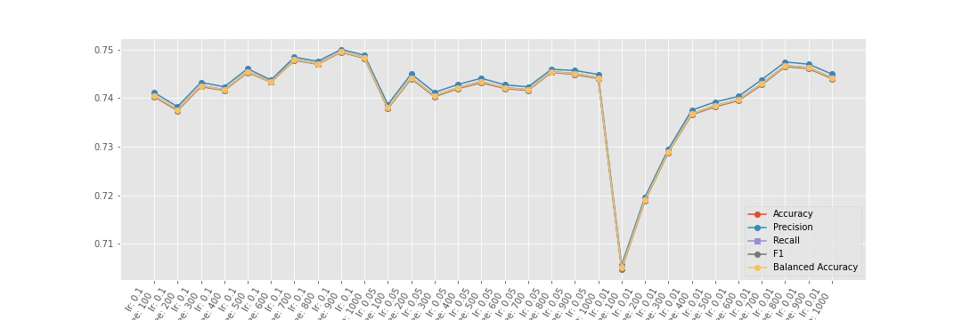
3. Results & Discussion
LGBMClassifier + Scaling + SMOTE
Scaling 이후 SMOTE를 이용한 Oversampling
>> 전반적인 성능 향상 / C가 2일 때 최대
Notes:
Total 14 compounds are selected from KCB library by rigorous selection criteria.
Among them, 12 compounds are experimentally validated because two compounds were unavailable in KCB.
Among them, 4 compounds were hERG inhibitors. 3 were moderate, and 1 was strong.
In this experiment, the hit rate is 33% which is significantly larger than reported random hit rate.
We can conclude that BayeshERG showed robust performance since it showed high hit rate even though the selected compounds are not easy to classify.

Slide 40
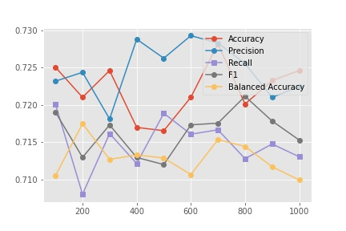
3. Results & Discussion
RandomForest
특별한 처리를 해주지 않았을 때의 성능
>> C가 16일 때, 모든 점수가 가장 높았고, 이후 감소하는 경향
Notes:
Total 14 compounds are selected from KCB library by rigorous selection criteria.
Among them, 12 compounds are experimentally validated because two compounds were unavailable in KCB.
Among them, 4 compounds were hERG inhibitors. 3 were moderate, and 1 was strong.
In this experiment, the hit rate is 33% which is significantly larger than reported random hit rate.
We can conclude that BayeshERG showed robust performance since it showed high hit rate even though the selected compounds are not easy to classify.

Slide 41
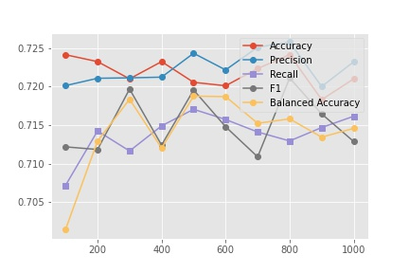
3. Results & Discussion
RandomForest + Scaling
MinMaxScaler를 이용한 Scaling 진행
>> C와 반비례하게 전반적인 성능이 감소
Notes:
Total 14 compounds are selected from KCB library by rigorous selection criteria.
Among them, 12 compounds are experimentally validated because two compounds were unavailable in KCB.
Among them, 4 compounds were hERG inhibitors. 3 were moderate, and 1 was strong.
In this experiment, the hit rate is 33% which is significantly larger than reported random hit rate.
We can conclude that BayeshERG showed robust performance since it showed high hit rate even though the selected compounds are not easy to classify.

Slide 42
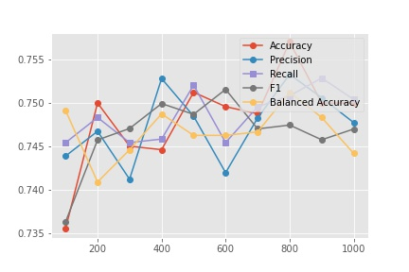
3. Results & Discussion
RandomForest + SMOTE
Scaling 이후 SMOTE를 이용한 Oversampling
>> 전반적인 성능 향상 / C가 2일 때 최대
Notes:
Total 14 compounds are selected from KCB library by rigorous selection criteria.
Among them, 12 compounds are experimentally validated because two compounds were unavailable in KCB.
Among them, 4 compounds were hERG inhibitors. 3 were moderate, and 1 was strong.
In this experiment, the hit rate is 33% which is significantly larger than reported random hit rate.
We can conclude that BayeshERG showed robust performance since it showed high hit rate even though the selected compounds are not easy to classify.

Slide 43
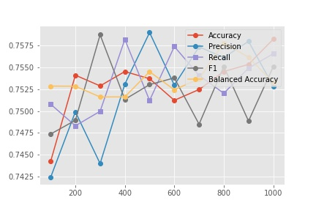
3. Results & Discussion
RandomForest + Scaling + SMOTE
Scaling 이후 SMOTE를 이용한 Oversampling
>> 전반적인 성능 향상 / C가 2일 때 최대
Notes:
Total 14 compounds are selected from KCB library by rigorous selection criteria.
Among them, 12 compounds are experimentally validated because two compounds were unavailable in KCB.
Among them, 4 compounds were hERG inhibitors. 3 were moderate, and 1 was strong.
In this experiment, the hit rate is 33% which is significantly larger than reported random hit rate.
We can conclude that BayeshERG showed robust performance since it showed high hit rate even though the selected compounds are not easy to classify.

Slide 44
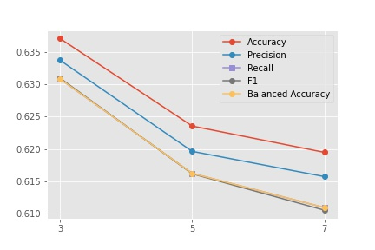
3. Results & Discussion
k-NN
특별한 처리를 해주지 않았을 때의 성능
>> C가 16일 때, 모든 점수가 가장 높았고, 이후 감소하는 경향
Notes:
Total 14 compounds are selected from KCB library by rigorous selection criteria.
Among them, 12 compounds are experimentally validated because two compounds were unavailable in KCB.
Among them, 4 compounds were hERG inhibitors. 3 were moderate, and 1 was strong.
In this experiment, the hit rate is 33% which is significantly larger than reported random hit rate.
We can conclude that BayeshERG showed robust performance since it showed high hit rate even though the selected compounds are not easy to classify.

Slide 45
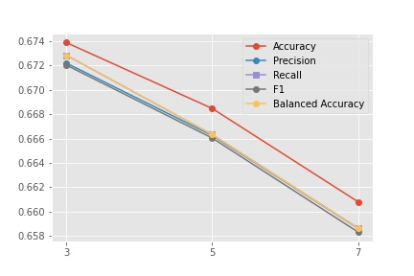
3. Results & Discussion
k-NN + Scaling
MinMaxScaler를 이용한 Scaling 진행
>> C와 반비례하게 전반적인 성능이 감소
Notes:
Total 14 compounds are selected from KCB library by rigorous selection criteria.
Among them, 12 compounds are experimentally validated because two compounds were unavailable in KCB.
Among them, 4 compounds were hERG inhibitors. 3 were moderate, and 1 was strong.
In this experiment, the hit rate is 33% which is significantly larger than reported random hit rate.
We can conclude that BayeshERG showed robust performance since it showed high hit rate even though the selected compounds are not easy to classify.

Slide 46
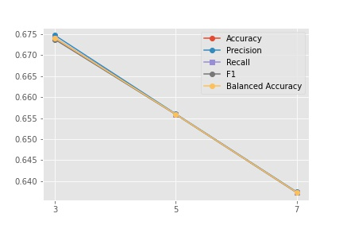
3. Results & Discussion
k-NN + SMOTE
Scaling 이후 SMOTE를 이용한 Oversampling
>> 전반적인 성능 향상 / C가 2일 때 최대
Notes:
Total 14 compounds are selected from KCB library by rigorous selection criteria.
Among them, 12 compounds are experimentally validated because two compounds were unavailable in KCB.
Among them, 4 compounds were hERG inhibitors. 3 were moderate, and 1 was strong.
In this experiment, the hit rate is 33% which is significantly larger than reported random hit rate.
We can conclude that BayeshERG showed robust performance since it showed high hit rate even though the selected compounds are not easy to classify.

Slide 47
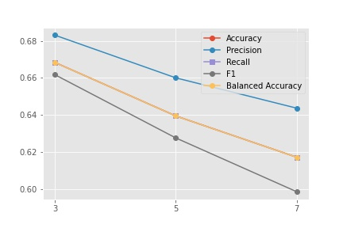
3. Results & Discussion
k-NN + Scaling + SMOTE
Scaling 이후 SMOTE를 이용한 Oversampling
>> 전반적인 성능 향상 / C가 2일 때 최대
Notes:
Total 14 compounds are selected from KCB library by rigorous selection criteria.
Among them, 12 compounds are experimentally validated because two compounds were unavailable in KCB.
Among them, 4 compounds were hERG inhibitors. 3 were moderate, and 1 was strong.
In this experiment, the hit rate is 33% which is significantly larger than reported random hit rate.
We can conclude that BayeshERG showed robust performance since it showed high hit rate even though the selected compounds are not easy to classify.

Slide 48
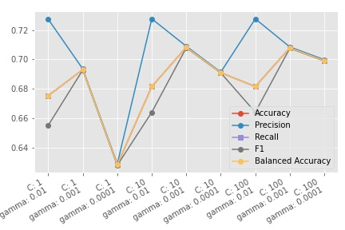
3. Results & Discussion
SVM(SVC)
특별한 처리를 해주지 않았을 때의 성능
>> C가 16일 때, 모든 점수가 가장 높았고, 이후 감소하는 경향
Notes:
Total 14 compounds are selected from KCB library by rigorous selection criteria.
Among them, 12 compounds are experimentally validated because two compounds were unavailable in KCB.
Among them, 4 compounds were hERG inhibitors. 3 were moderate, and 1 was strong.
In this experiment, the hit rate is 33% which is significantly larger than reported random hit rate.
We can conclude that BayeshERG showed robust performance since it showed high hit rate even though the selected compounds are not easy to classify.

Slide 49
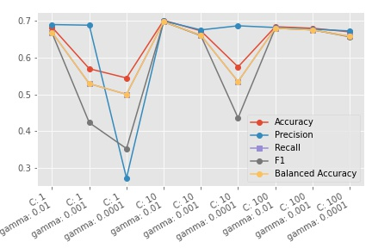
3. Results & Discussion
SVM(SVC) + Scaling
MinMaxScaler를 이용한 Scaling 진행
>> C와 반비례하게 전반적인 성능이 감소
Notes:
Total 14 compounds are selected from KCB library by rigorous selection criteria.
Among them, 12 compounds are experimentally validated because two compounds were unavailable in KCB.
Among them, 4 compounds were hERG inhibitors. 3 were moderate, and 1 was strong.
In this experiment, the hit rate is 33% which is significantly larger than reported random hit rate.
We can conclude that BayeshERG showed robust performance since it showed high hit rate even though the selected compounds are not easy to classify.

Slide 50

3. Results & Discussion
SVM(SVC) + SMOTE
Scaling 이후 SMOTE를 이용한 Oversampling
>> 전반적인 성능 향상 / C가 2일 때 최대
Notes:
Total 14 compounds are selected from KCB library by rigorous selection criteria.
Among them, 12 compounds are experimentally validated because two compounds were unavailable in KCB.
Among them, 4 compounds were hERG inhibitors. 3 were moderate, and 1 was strong.
In this experiment, the hit rate is 33% which is significantly larger than reported random hit rate.
We can conclude that BayeshERG showed robust performance since it showed high hit rate even though the selected compounds are not easy to classify.

Slide 51
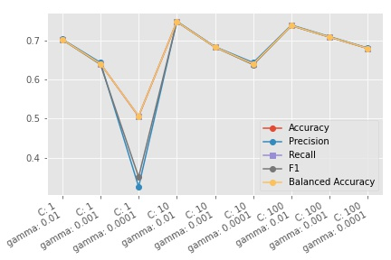
3. Results & Discussion
SVM(SVC) + Scaling + SMOTE
Scaling 이후 SMOTE를 이용한 Oversampling
>> 전반적인 성능 향상 / C가 2일 때 최대
Notes:
Total 14 compounds are selected from KCB library by rigorous selection criteria.
Among them, 12 compounds are experimentally validated because two compounds were unavailable in KCB.
Among them, 4 compounds were hERG inhibitors. 3 were moderate, and 1 was strong.
In this experiment, the hit rate is 33% which is significantly larger than reported random hit rate.
We can conclude that BayeshERG showed robust performance since it showed high hit rate even though the selected compounds are not easy to classify.

Slide 52
3. Results & Discussion
AMES Mutagenicity
Notes:
Total 14 compounds are selected from KCB library by rigorous selection criteria.
Among them, 12 compounds are experimentally validated because two compounds were unavailable in KCB.
Among them, 4 compounds were hERG inhibitors. 3 were moderate, and 1 was strong.
In this experiment, the hit rate is 33% which is significantly larger than reported random hit rate.
We can conclude that BayeshERG showed robust performance since it showed high hit rate even though the selected compounds are not easy to classify.

Slide 53
3. Results & Discussion
Logistic Regression
특별한 처리를 해주지 않았을 때의 성능
>>
Notes:
Total 14 compounds are selected from KCB library by rigorous selection criteria.
Among them, 12 compounds are experimentally validated because two compounds were unavailable in KCB.
Among them, 4 compounds were hERG inhibitors. 3 were moderate, and 1 was strong.
In this experiment, the hit rate is 33% which is significantly larger than reported random hit rate.
We can conclude that BayeshERG showed robust performance since it showed high hit rate even though the selected compounds are not easy to classify.

Slide 54
3. Results & Discussion
Logistic Regression + Scaling
MinMaxScaler를 이용한 Scaling 진행
>>
Notes:
Total 14 compounds are selected from KCB library by rigorous selection criteria.
Among them, 12 compounds are experimentally validated because two compounds were unavailable in KCB.
Among them, 4 compounds were hERG inhibitors. 3 were moderate, and 1 was strong.
In this experiment, the hit rate is 33% which is significantly larger than reported random hit rate.
We can conclude that BayeshERG showed robust performance since it showed high hit rate even though the selected compounds are not easy to classify.

Slide 55
3. Results & Discussion
Logistic Regression + SMOTE
SMOTE를 이용한 Oversampling
>>
Notes:
Total 14 compounds are selected from KCB library by rigorous selection criteria.
Among them, 12 compounds are experimentally validated because two compounds were unavailable in KCB.
Among them, 4 compounds were hERG inhibitors. 3 were moderate, and 1 was strong.
In this experiment, the hit rate is 33% which is significantly larger than reported random hit rate.
We can conclude that BayeshERG showed robust performance since it showed high hit rate even though the selected compounds are not easy to classify.

Slide 56
3. Results & Discussion
Logistic Regression + Scaling + SMOTE
Scaling 이후 SMOTE를 이용한 Oversampling
>>
Notes:
Total 14 compounds are selected from KCB library by rigorous selection criteria.
Among them, 12 compounds are experimentally validated because two compounds were unavailable in KCB.
Among them, 4 compounds were hERG inhibitors. 3 were moderate, and 1 was strong.
In this experiment, the hit rate is 33% which is significantly larger than reported random hit rate.
We can conclude that BayeshERG showed robust performance since it showed high hit rate even though the selected compounds are not easy to classify.

Slide 57
3. Results & Discussion
LGBMClassifier
특별한 처리를 해주지 않았을 때의 성능
>>
Notes:
Total 14 compounds are selected from KCB library by rigorous selection criteria.
Among them, 12 compounds are experimentally validated because two compounds were unavailable in KCB.
Among them, 4 compounds were hERG inhibitors. 3 were moderate, and 1 was strong.
In this experiment, the hit rate is 33% which is significantly larger than reported random hit rate.
We can conclude that BayeshERG showed robust performance since it showed high hit rate even though the selected compounds are not easy to classify.

Slide 58
3. Results & Discussion
LGBMClassifier + Scaling
MinMaxScaler를 이용한 Scaling 진행
>>
Notes:
Total 14 compounds are selected from KCB library by rigorous selection criteria.
Among them, 12 compounds are experimentally validated because two compounds were unavailable in KCB.
Among them, 4 compounds were hERG inhibitors. 3 were moderate, and 1 was strong.
In this experiment, the hit rate is 33% which is significantly larger than reported random hit rate.
We can conclude that BayeshERG showed robust performance since it showed high hit rate even though the selected compounds are not easy to classify.

Slide 59
3. Results & Discussion
LGBMClassifier + SMOTE
SMOTE를 이용한 Oversampling
>>
Notes:
Total 14 compounds are selected from KCB library by rigorous selection criteria.
Among them, 12 compounds are experimentally validated because two compounds were unavailable in KCB.
Among them, 4 compounds were hERG inhibitors. 3 were moderate, and 1 was strong.
In this experiment, the hit rate is 33% which is significantly larger than reported random hit rate.
We can conclude that BayeshERG showed robust performance since it showed high hit rate even though the selected compounds are not easy to classify.

Slide 60
3. Results & Discussion
LGBMClassifier + Scaling + SMOTE
Scaling 이후 SMOTE를 이용한 Oversampling
>>
Notes:
Total 14 compounds are selected from KCB library by rigorous selection criteria.
Among them, 12 compounds are experimentally validated because two compounds were unavailable in KCB.
Among them, 4 compounds were hERG inhibitors. 3 were moderate, and 1 was strong.
In this experiment, the hit rate is 33% which is significantly larger than reported random hit rate.
We can conclude that BayeshERG showed robust performance since it showed high hit rate even though the selected compounds are not easy to classify.

Slide 61
3. Results & Discussion
RandomForest
특별한 처리를 해주지 않았을 때의 성능
>>
Notes:
Total 14 compounds are selected from KCB library by rigorous selection criteria.
Among them, 12 compounds are experimentally validated because two compounds were unavailable in KCB.
Among them, 4 compounds were hERG inhibitors. 3 were moderate, and 1 was strong.
In this experiment, the hit rate is 33% which is significantly larger than reported random hit rate.
We can conclude that BayeshERG showed robust performance since it showed high hit rate even though the selected compounds are not easy to classify.

Slide 62
3. Results & Discussion
RandomForest + Scaling
MinMaxScaler를 이용한 Scaling 진행
>>
Notes:
Total 14 compounds are selected from KCB library by rigorous selection criteria.
Among them, 12 compounds are experimentally validated because two compounds were unavailable in KCB.
Among them, 4 compounds were hERG inhibitors. 3 were moderate, and 1 was strong.
In this experiment, the hit rate is 33% which is significantly larger than reported random hit rate.
We can conclude that BayeshERG showed robust performance since it showed high hit rate even though the selected compounds are not easy to classify.

Slide 63
3. Results & Discussion
RandomForest + SMOTE
SMOTE를 이용한 Oversampling
>>
Notes:
Total 14 compounds are selected from KCB library by rigorous selection criteria.
Among them, 12 compounds are experimentally validated because two compounds were unavailable in KCB.
Among them, 4 compounds were hERG inhibitors. 3 were moderate, and 1 was strong.
In this experiment, the hit rate is 33% which is significantly larger than reported random hit rate.
We can conclude that BayeshERG showed robust performance since it showed high hit rate even though the selected compounds are not easy to classify.

Slide 64
3. Results & Discussion
RandomForest + Scaling + SMOTE
Scaling 이후 SMOTE를 이용한 Oversampling
>>
Notes:
Total 14 compounds are selected from KCB library by rigorous selection criteria.
Among them, 12 compounds are experimentally validated because two compounds were unavailable in KCB.
Among them, 4 compounds were hERG inhibitors. 3 were moderate, and 1 was strong.
In this experiment, the hit rate is 33% which is significantly larger than reported random hit rate.
We can conclude that BayeshERG showed robust performance since it showed high hit rate even though the selected compounds are not easy to classify.

Slide 65
3. Results & Discussion
k-NN
특별한 처리를 해주지 않았을 때의 성능
>>
Notes:
Total 14 compounds are selected from KCB library by rigorous selection criteria.
Among them, 12 compounds are experimentally validated because two compounds were unavailable in KCB.
Among them, 4 compounds were hERG inhibitors. 3 were moderate, and 1 was strong.
In this experiment, the hit rate is 33% which is significantly larger than reported random hit rate.
We can conclude that BayeshERG showed robust performance since it showed high hit rate even though the selected compounds are not easy to classify.

Slide 66
3. Results & Discussion
k-NN + Scaling
MinMaxScaler를 이용한 Scaling 진행
>>
Notes:
Total 14 compounds are selected from KCB library by rigorous selection criteria.
Among them, 12 compounds are experimentally validated because two compounds were unavailable in KCB.
Among them, 4 compounds were hERG inhibitors. 3 were moderate, and 1 was strong.
In this experiment, the hit rate is 33% which is significantly larger than reported random hit rate.
We can conclude that BayeshERG showed robust performance since it showed high hit rate even though the selected compounds are not easy to classify.

Slide 67
3. Results & Discussion
k-NN + SMOTE
SMOTE를 이용한 Oversampling
>>
Notes:
Total 14 compounds are selected from KCB library by rigorous selection criteria.
Among them, 12 compounds are experimentally validated because two compounds were unavailable in KCB.
Among them, 4 compounds were hERG inhibitors. 3 were moderate, and 1 was strong.
In this experiment, the hit rate is 33% which is significantly larger than reported random hit rate.
We can conclude that BayeshERG showed robust performance since it showed high hit rate even though the selected compounds are not easy to classify.

Slide 68
3. Results & Discussion
k-NN + Scaling + SMOTE
Scaling 이후 SMOTE를 이용한 Oversampling
>>
Notes:
Total 14 compounds are selected from KCB library by rigorous selection criteria.
Among them, 12 compounds are experimentally validated because two compounds were unavailable in KCB.
Among them, 4 compounds were hERG inhibitors. 3 were moderate, and 1 was strong.
In this experiment, the hit rate is 33% which is significantly larger than reported random hit rate.
We can conclude that BayeshERG showed robust performance since it showed high hit rate even though the selected compounds are not easy to classify.

Slide 69
3. Results & Discussion
SVM(SVC)
특별한 처리를 해주지 않았을 때의 성능
>>
Notes:
Total 14 compounds are selected from KCB library by rigorous selection criteria.
Among them, 12 compounds are experimentally validated because two compounds were unavailable in KCB.
Among them, 4 compounds were hERG inhibitors. 3 were moderate, and 1 was strong.
In this experiment, the hit rate is 33% which is significantly larger than reported random hit rate.
We can conclude that BayeshERG showed robust performance since it showed high hit rate even though the selected compounds are not easy to classify.

Slide 70
3. Results & Discussion
SVM(SVC) + Scaling
MinMaxScaler를 이용한 Scaling 진행
>>
Notes:
Total 14 compounds are selected from KCB library by rigorous selection criteria.
Among them, 12 compounds are experimentally validated because two compounds were unavailable in KCB.
Among them, 4 compounds were hERG inhibitors. 3 were moderate, and 1 was strong.
In this experiment, the hit rate is 33% which is significantly larger than reported random hit rate.
We can conclude that BayeshERG showed robust performance since it showed high hit rate even though the selected compounds are not easy to classify.

Slide 71
3. Results & Discussion
SVM(SVC) + SMOTE
SMOTE를 이용한 Oversampling
>>
Notes:
Total 14 compounds are selected from KCB library by rigorous selection criteria.
Among them, 12 compounds are experimentally validated because two compounds were unavailable in KCB.
Among them, 4 compounds were hERG inhibitors. 3 were moderate, and 1 was strong.
In this experiment, the hit rate is 33% which is significantly larger than reported random hit rate.
We can conclude that BayeshERG showed robust performance since it showed high hit rate even though the selected compounds are not easy to classify.

Slide 72
3. Results & Discussion
SVM(SVC) + Scaling + SMOTE
Scaling 이후 SMOTE를 이용한 Oversampling
>>
Notes:
Total 14 compounds are selected from KCB library by rigorous selection criteria.
Among them, 12 compounds are experimentally validated because two compounds were unavailable in KCB.
Among them, 4 compounds were hERG inhibitors. 3 were moderate, and 1 was strong.
In this experiment, the hit rate is 33% which is significantly larger than reported random hit rate.
We can conclude that BayeshERG showed robust performance since it showed high hit rate even though the selected compounds are not easy to classify.

Slide 73
3. Results & Discussion
hERG
Notes:
Total 14 compounds are selected from KCB library by rigorous selection criteria.
Among them, 12 compounds are experimentally validated because two compounds were unavailable in KCB.
Among them, 4 compounds were hERG inhibitors. 3 were moderate, and 1 was strong.
In this experiment, the hit rate is 33% which is significantly larger than reported random hit rate.
We can conclude that BayeshERG showed robust performance since it showed high hit rate even though the selected compounds are not easy to classify.

Slide 74
3. Results & Discussion
Acute Oral Toxicity (Rat)
EPA_category (4 classes)
Notes:
Total 14 compounds are selected from KCB library by rigorous selection criteria.
Among them, 12 compounds are experimentally validated because two compounds were unavailable in KCB.
Among them, 4 compounds were hERG inhibitors. 3 were moderate, and 1 was strong.
In this experiment, the hit rate is 33% which is significantly larger than reported random hit rate.
We can conclude that BayeshERG showed robust performance since it showed high hit rate even though the selected compounds are not easy to classify.

Slide 75
3. Results & Discussion
Logistic Regression
특별한 처리를 해주지 않았을 때의 성능
>>
Notes:
Total 14 compounds are selected from KCB library by rigorous selection criteria.
Among them, 12 compounds are experimentally validated because two compounds were unavailable in KCB.
Among them, 4 compounds were hERG inhibitors. 3 were moderate, and 1 was strong.
In this experiment, the hit rate is 33% which is significantly larger than reported random hit rate.
We can conclude that BayeshERG showed robust performance since it showed high hit rate even though the selected compounds are not easy to classify.

Slide 76
3. Results & Discussion
Logistic Regression + Scaling
MinMaxScaler를 이용한 Scaling 진행
>>
Notes:
Total 14 compounds are selected from KCB library by rigorous selection criteria.
Among them, 12 compounds are experimentally validated because two compounds were unavailable in KCB.
Among them, 4 compounds were hERG inhibitors. 3 were moderate, and 1 was strong.
In this experiment, the hit rate is 33% which is significantly larger than reported random hit rate.
We can conclude that BayeshERG showed robust performance since it showed high hit rate even though the selected compounds are not easy to classify.

Slide 77
3. Results & Discussion
Logistic Regression + SMOTE
SMOTE를 이용한 Oversampling
>>
Notes:
Total 14 compounds are selected from KCB library by rigorous selection criteria.
Among them, 12 compounds are experimentally validated because two compounds were unavailable in KCB.
Among them, 4 compounds were hERG inhibitors. 3 were moderate, and 1 was strong.
In this experiment, the hit rate is 33% which is significantly larger than reported random hit rate.
We can conclude that BayeshERG showed robust performance since it showed high hit rate even though the selected compounds are not easy to classify.

Slide 78
3. Results & Discussion
Logistic Regression + Scaling + SMOTE
Scaling 이후 SMOTE를 이용한 Oversampling
>>
Notes:
Total 14 compounds are selected from KCB library by rigorous selection criteria.
Among them, 12 compounds are experimentally validated because two compounds were unavailable in KCB.
Among them, 4 compounds were hERG inhibitors. 3 were moderate, and 1 was strong.
In this experiment, the hit rate is 33% which is significantly larger than reported random hit rate.
We can conclude that BayeshERG showed robust performance since it showed high hit rate even though the selected compounds are not easy to classify.

Slide 79
3. Results & Discussion
LGBMClassifier
특별한 처리를 해주지 않았을 때의 성능
>>
Notes:
Total 14 compounds are selected from KCB library by rigorous selection criteria.
Among them, 12 compounds are experimentally validated because two compounds were unavailable in KCB.
Among them, 4 compounds were hERG inhibitors. 3 were moderate, and 1 was strong.
In this experiment, the hit rate is 33% which is significantly larger than reported random hit rate.
We can conclude that BayeshERG showed robust performance since it showed high hit rate even though the selected compounds are not easy to classify.

Slide 80
3. Results & Discussion
LGBMClassifier + Scaling
MinMaxScaler를 이용한 Scaling 진행
>>
Notes:
Total 14 compounds are selected from KCB library by rigorous selection criteria.
Among them, 12 compounds are experimentally validated because two compounds were unavailable in KCB.
Among them, 4 compounds were hERG inhibitors. 3 were moderate, and 1 was strong.
In this experiment, the hit rate is 33% which is significantly larger than reported random hit rate.
We can conclude that BayeshERG showed robust performance since it showed high hit rate even though the selected compounds are not easy to classify.

Slide 81
3. Results & Discussion
LGBMClassifier + SMOTE
SMOTE를 이용한 Oversampling
>>
Notes:
Total 14 compounds are selected from KCB library by rigorous selection criteria.
Among them, 12 compounds are experimentally validated because two compounds were unavailable in KCB.
Among them, 4 compounds were hERG inhibitors. 3 were moderate, and 1 was strong.
In this experiment, the hit rate is 33% which is significantly larger than reported random hit rate.
We can conclude that BayeshERG showed robust performance since it showed high hit rate even though the selected compounds are not easy to classify.

Slide 82
3. Results & Discussion
LGBMClassifier + Scaling + SMOTE
Scaling 이후 SMOTE를 이용한 Oversampling
>>
Notes:
Total 14 compounds are selected from KCB library by rigorous selection criteria.
Among them, 12 compounds are experimentally validated because two compounds were unavailable in KCB.
Among them, 4 compounds were hERG inhibitors. 3 were moderate, and 1 was strong.
In this experiment, the hit rate is 33% which is significantly larger than reported random hit rate.
We can conclude that BayeshERG showed robust performance since it showed high hit rate even though the selected compounds are not easy to classify.

Slide 83
3. Results & Discussion
RandomForest
특별한 처리를 해주지 않았을 때의 성능
>>
Notes:
Total 14 compounds are selected from KCB library by rigorous selection criteria.
Among them, 12 compounds are experimentally validated because two compounds were unavailable in KCB.
Among them, 4 compounds were hERG inhibitors. 3 were moderate, and 1 was strong.
In this experiment, the hit rate is 33% which is significantly larger than reported random hit rate.
We can conclude that BayeshERG showed robust performance since it showed high hit rate even though the selected compounds are not easy to classify.

Slide 84
3. Results & Discussion
RandomForest + Scaling
MinMaxScaler를 이용한 Scaling 진행
>>
Notes:
Total 14 compounds are selected from KCB library by rigorous selection criteria.
Among them, 12 compounds are experimentally validated because two compounds were unavailable in KCB.
Among them, 4 compounds were hERG inhibitors. 3 were moderate, and 1 was strong.
In this experiment, the hit rate is 33% which is significantly larger than reported random hit rate.
We can conclude that BayeshERG showed robust performance since it showed high hit rate even though the selected compounds are not easy to classify.

Slide 85
3. Results & Discussion
RandomForest + SMOTE
SMOTE를 이용한 Oversampling
>>
Notes:
Total 14 compounds are selected from KCB library by rigorous selection criteria.
Among them, 12 compounds are experimentally validated because two compounds were unavailable in KCB.
Among them, 4 compounds were hERG inhibitors. 3 were moderate, and 1 was strong.
In this experiment, the hit rate is 33% which is significantly larger than reported random hit rate.
We can conclude that BayeshERG showed robust performance since it showed high hit rate even though the selected compounds are not easy to classify.

Slide 86
3. Results & Discussion
RandomForest + Scaling + SMOTE
Scaling 이후 SMOTE를 이용한 Oversampling
>>
Notes:
Total 14 compounds are selected from KCB library by rigorous selection criteria.
Among them, 12 compounds are experimentally validated because two compounds were unavailable in KCB.
Among them, 4 compounds were hERG inhibitors. 3 were moderate, and 1 was strong.
In this experiment, the hit rate is 33% which is significantly larger than reported random hit rate.
We can conclude that BayeshERG showed robust performance since it showed high hit rate even though the selected compounds are not easy to classify.

Slide 87
3. Results & Discussion
k-NN
특별한 처리를 해주지 않았을 때의 성능
>>
Notes:
Total 14 compounds are selected from KCB library by rigorous selection criteria.
Among them, 12 compounds are experimentally validated because two compounds were unavailable in KCB.
Among them, 4 compounds were hERG inhibitors. 3 were moderate, and 1 was strong.
In this experiment, the hit rate is 33% which is significantly larger than reported random hit rate.
We can conclude that BayeshERG showed robust performance since it showed high hit rate even though the selected compounds are not easy to classify.

Slide 88
3. Results & Discussion
k-NN + Scaling
MinMaxScaler를 이용한 Scaling 진행
>>
Notes:
Total 14 compounds are selected from KCB library by rigorous selection criteria.
Among them, 12 compounds are experimentally validated because two compounds were unavailable in KCB.
Among them, 4 compounds were hERG inhibitors. 3 were moderate, and 1 was strong.
In this experiment, the hit rate is 33% which is significantly larger than reported random hit rate.
We can conclude that BayeshERG showed robust performance since it showed high hit rate even though the selected compounds are not easy to classify.

Slide 89
3. Results & Discussion
k-NN + SMOTE
SMOTE를 이용한 Oversampling
>>
Notes:
Total 14 compounds are selected from KCB library by rigorous selection criteria.
Among them, 12 compounds are experimentally validated because two compounds were unavailable in KCB.
Among them, 4 compounds were hERG inhibitors. 3 were moderate, and 1 was strong.
In this experiment, the hit rate is 33% which is significantly larger than reported random hit rate.
We can conclude that BayeshERG showed robust performance since it showed high hit rate even though the selected compounds are not easy to classify.

Slide 90
3. Results & Discussion
k-NN + Scaling + SMOTE
Scaling 이후 SMOTE를 이용한 Oversampling
>>
Notes:
Total 14 compounds are selected from KCB library by rigorous selection criteria.
Among them, 12 compounds are experimentally validated because two compounds were unavailable in KCB.
Among them, 4 compounds were hERG inhibitors. 3 were moderate, and 1 was strong.
In this experiment, the hit rate is 33% which is significantly larger than reported random hit rate.
We can conclude that BayeshERG showed robust performance since it showed high hit rate even though the selected compounds are not easy to classify.

Slide 91
3. Results & Discussion
SVM(SVC)
특별한 처리를 해주지 않았을 때의 성능
>>
Notes:
Total 14 compounds are selected from KCB library by rigorous selection criteria.
Among them, 12 compounds are experimentally validated because two compounds were unavailable in KCB.
Among them, 4 compounds were hERG inhibitors. 3 were moderate, and 1 was strong.
In this experiment, the hit rate is 33% which is significantly larger than reported random hit rate.
We can conclude that BayeshERG showed robust performance since it showed high hit rate even though the selected compounds are not easy to classify.

Slide 92
3. Results & Discussion
SVM(SVC) + Scaling
MinMaxScaler를 이용한 Scaling 진행
>>
Notes:
Total 14 compounds are selected from KCB library by rigorous selection criteria.
Among them, 12 compounds are experimentally validated because two compounds were unavailable in KCB.
Among them, 4 compounds were hERG inhibitors. 3 were moderate, and 1 was strong.
In this experiment, the hit rate is 33% which is significantly larger than reported random hit rate.
We can conclude that BayeshERG showed robust performance since it showed high hit rate even though the selected compounds are not easy to classify.

Slide 93
3. Results & Discussion
SVM(SVC) + SMOTE
SMOTE를 이용한 Oversampling
>>
Notes:
Total 14 compounds are selected from KCB library by rigorous selection criteria.
Among them, 12 compounds are experimentally validated because two compounds were unavailable in KCB.
Among them, 4 compounds were hERG inhibitors. 3 were moderate, and 1 was strong.
In this experiment, the hit rate is 33% which is significantly larger than reported random hit rate.
We can conclude that BayeshERG showed robust performance since it showed high hit rate even though the selected compounds are not easy to classify.

Slide 94
3. Results & Discussion
SVM(SVC) + Scaling + SMOTE
Scaling 이후 SMOTE를 이용한 Oversampling
>>
Notes:
Total 14 compounds are selected from KCB library by rigorous selection criteria.
Among them, 12 compounds are experimentally validated because two compounds were unavailable in KCB.
Among them, 4 compounds were hERG inhibitors. 3 were moderate, and 1 was strong.
In this experiment, the hit rate is 33% which is significantly larger than reported random hit rate.
We can conclude that BayeshERG showed robust performance since it showed high hit rate even though the selected compounds are not easy to classify.

Slide 95
3. Results & Discussion
Logistic Regression
특별한 처리를 해주지 않았을 때의 성능
>>
Notes:
Total 14 compounds are selected from KCB library by rigorous selection criteria.
Among them, 12 compounds are experimentally validated because two compounds were unavailable in KCB.
Among them, 4 compounds were hERG inhibitors. 3 were moderate, and 1 was strong.
In this experiment, the hit rate is 33% which is significantly larger than reported random hit rate.
We can conclude that BayeshERG showed robust performance since it showed high hit rate even though the selected compounds are not easy to classify.

Slide 96
3. Results & Discussion
Logistic Regression + Scaling
MinMaxScaler를 이용한 Scaling 진행
>>
Notes:
Total 14 compounds are selected from KCB library by rigorous selection criteria.
Among them, 12 compounds are experimentally validated because two compounds were unavailable in KCB.
Among them, 4 compounds were hERG inhibitors. 3 were moderate, and 1 was strong.
In this experiment, the hit rate is 33% which is significantly larger than reported random hit rate.
We can conclude that BayeshERG showed robust performance since it showed high hit rate even though the selected compounds are not easy to classify.

Slide 97
3. Results & Discussion
Logistic Regression + SMOTE
SMOTE를 이용한 Oversampling
>>
Notes:
Total 14 compounds are selected from KCB library by rigorous selection criteria.
Among them, 12 compounds are experimentally validated because two compounds were unavailable in KCB.
Among them, 4 compounds were hERG inhibitors. 3 were moderate, and 1 was strong.
In this experiment, the hit rate is 33% which is significantly larger than reported random hit rate.
We can conclude that BayeshERG showed robust performance since it showed high hit rate even though the selected compounds are not easy to classify.

Slide 98
3. Results & Discussion
Logistic Regression + Scaling + SMOTE
Scaling 이후 SMOTE를 이용한 Oversampling
>>
Notes:
Total 14 compounds are selected from KCB library by rigorous selection criteria.
Among them, 12 compounds are experimentally validated because two compounds were unavailable in KCB.
Among them, 4 compounds were hERG inhibitors. 3 were moderate, and 1 was strong.
In this experiment, the hit rate is 33% which is significantly larger than reported random hit rate.
We can conclude that BayeshERG showed robust performance since it showed high hit rate even though the selected compounds are not easy to classify.

Slide 99
3. Results & Discussion
LGBMClassifier
특별한 처리를 해주지 않았을 때의 성능
>>
Notes:
Total 14 compounds are selected from KCB library by rigorous selection criteria.
Among them, 12 compounds are experimentally validated because two compounds were unavailable in KCB.
Among them, 4 compounds were hERG inhibitors. 3 were moderate, and 1 was strong.
In this experiment, the hit rate is 33% which is significantly larger than reported random hit rate.
We can conclude that BayeshERG showed robust performance since it showed high hit rate even though the selected compounds are not easy to classify.

Slide 100
3. Results & Discussion
LGBMClassifier + Scaling
MinMaxScaler를 이용한 Scaling 진행
>>
Notes:
Total 14 compounds are selected from KCB library by rigorous selection criteria.
Among them, 12 compounds are experimentally validated because two compounds were unavailable in KCB.
Among them, 4 compounds were hERG inhibitors. 3 were moderate, and 1 was strong.
In this experiment, the hit rate is 33% which is significantly larger than reported random hit rate.
We can conclude that BayeshERG showed robust performance since it showed high hit rate even though the selected compounds are not easy to classify.

Slide 101
3. Results & Discussion
LGBMClassifier + SMOTE
SMOTE를 이용한 Oversampling
>>
Notes:
Total 14 compounds are selected from KCB library by rigorous selection criteria.
Among them, 12 compounds are experimentally validated because two compounds were unavailable in KCB.
Among them, 4 compounds were hERG inhibitors. 3 were moderate, and 1 was strong.
In this experiment, the hit rate is 33% which is significantly larger than reported random hit rate.
We can conclude that BayeshERG showed robust performance since it showed high hit rate even though the selected compounds are not easy to classify.

Slide 102
3. Results & Discussion
LGBMClassifier + Scaling + SMOTE
Scaling 이후 SMOTE를 이용한 Oversampling
>>
Notes:
Total 14 compounds are selected from KCB library by rigorous selection criteria.
Among them, 12 compounds are experimentally validated because two compounds were unavailable in KCB.
Among them, 4 compounds were hERG inhibitors. 3 were moderate, and 1 was strong.
In this experiment, the hit rate is 33% which is significantly larger than reported random hit rate.
We can conclude that BayeshERG showed robust performance since it showed high hit rate even though the selected compounds are not easy to classify.

Slide 103
3. Results & Discussion
RandomForest
특별한 처리를 해주지 않았을 때의 성능
>>
Notes:
Total 14 compounds are selected from KCB library by rigorous selection criteria.
Among them, 12 compounds are experimentally validated because two compounds were unavailable in KCB.
Among them, 4 compounds were hERG inhibitors. 3 were moderate, and 1 was strong.
In this experiment, the hit rate is 33% which is significantly larger than reported random hit rate.
We can conclude that BayeshERG showed robust performance since it showed high hit rate even though the selected compounds are not easy to classify.

Slide 104
3. Results & Discussion
RandomForest + Scaling
MinMaxScaler를 이용한 Scaling 진행
>>
Notes:
Total 14 compounds are selected from KCB library by rigorous selection criteria.
Among them, 12 compounds are experimentally validated because two compounds were unavailable in KCB.
Among them, 4 compounds were hERG inhibitors. 3 were moderate, and 1 was strong.
In this experiment, the hit rate is 33% which is significantly larger than reported random hit rate.
We can conclude that BayeshERG showed robust performance since it showed high hit rate even though the selected compounds are not easy to classify.

Slide 105
3. Results & Discussion
RandomForest + SMOTE
SMOTE를 이용한 Oversampling
>>
Notes:
Total 14 compounds are selected from KCB library by rigorous selection criteria.
Among them, 12 compounds are experimentally validated because two compounds were unavailable in KCB.
Among them, 4 compounds were hERG inhibitors. 3 were moderate, and 1 was strong.
In this experiment, the hit rate is 33% which is significantly larger than reported random hit rate.
We can conclude that BayeshERG showed robust performance since it showed high hit rate even though the selected compounds are not easy to classify.

Slide 106
3. Results & Discussion
RandomForest + Scaling + SMOTE
Scaling 이후 SMOTE를 이용한 Oversampling
>>
Notes:
Total 14 compounds are selected from KCB library by rigorous selection criteria.
Among them, 12 compounds are experimentally validated because two compounds were unavailable in KCB.
Among them, 4 compounds were hERG inhibitors. 3 were moderate, and 1 was strong.
In this experiment, the hit rate is 33% which is significantly larger than reported random hit rate.
We can conclude that BayeshERG showed robust performance since it showed high hit rate even though the selected compounds are not easy to classify.

Slide 107
3. Results & Discussion
k-NN
특별한 처리를 해주지 않았을 때의 성능
>>
Notes:
Total 14 compounds are selected from KCB library by rigorous selection criteria.
Among them, 12 compounds are experimentally validated because two compounds were unavailable in KCB.
Among them, 4 compounds were hERG inhibitors. 3 were moderate, and 1 was strong.
In this experiment, the hit rate is 33% which is significantly larger than reported random hit rate.
We can conclude that BayeshERG showed robust performance since it showed high hit rate even though the selected compounds are not easy to classify.

Slide 108
3. Results & Discussion
k-NN + Scaling
MinMaxScaler를 이용한 Scaling 진행
>>
Notes:
Total 14 compounds are selected from KCB library by rigorous selection criteria.
Among them, 12 compounds are experimentally validated because two compounds were unavailable in KCB.
Among them, 4 compounds were hERG inhibitors. 3 were moderate, and 1 was strong.
In this experiment, the hit rate is 33% which is significantly larger than reported random hit rate.
We can conclude that BayeshERG showed robust performance since it showed high hit rate even though the selected compounds are not easy to classify.

Slide 109
3. Results & Discussion
k-NN + SMOTE
SMOTE를 이용한 Oversampling
>>
Notes:
Total 14 compounds are selected from KCB library by rigorous selection criteria.
Among them, 12 compounds are experimentally validated because two compounds were unavailable in KCB.
Among them, 4 compounds were hERG inhibitors. 3 were moderate, and 1 was strong.
In this experiment, the hit rate is 33% which is significantly larger than reported random hit rate.
We can conclude that BayeshERG showed robust performance since it showed high hit rate even though the selected compounds are not easy to classify.

Slide 110
3. Results & Discussion
k-NN + Scaling + SMOTE
Scaling 이후 SMOTE를 이용한 Oversampling
>>
Notes:
Total 14 compounds are selected from KCB library by rigorous selection criteria.
Among them, 12 compounds are experimentally validated because two compounds were unavailable in KCB.
Among them, 4 compounds were hERG inhibitors. 3 were moderate, and 1 was strong.
In this experiment, the hit rate is 33% which is significantly larger than reported random hit rate.
We can conclude that BayeshERG showed robust performance since it showed high hit rate even though the selected compounds are not easy to classify.

Slide 111
3. Results & Discussion
SVM(SVC)
특별한 처리를 해주지 않았을 때의 성능
>>
Notes:
Total 14 compounds are selected from KCB library by rigorous selection criteria.
Among them, 12 compounds are experimentally validated because two compounds were unavailable in KCB.
Among them, 4 compounds were hERG inhibitors. 3 were moderate, and 1 was strong.
In this experiment, the hit rate is 33% which is significantly larger than reported random hit rate.
We can conclude that BayeshERG showed robust performance since it showed high hit rate even though the selected compounds are not easy to classify.

Slide 112
3. Results & Discussion
SVM(SVC) + Scaling
MinMaxScaler를 이용한 Scaling 진행
>>
Notes:
Total 14 compounds are selected from KCB library by rigorous selection criteria.
Among them, 12 compounds are experimentally validated because two compounds were unavailable in KCB.
Among them, 4 compounds were hERG inhibitors. 3 were moderate, and 1 was strong.
In this experiment, the hit rate is 33% which is significantly larger than reported random hit rate.
We can conclude that BayeshERG showed robust performance since it showed high hit rate even though the selected compounds are not easy to classify.

Slide 113
3. Results & Discussion
SVM(SVC) + SMOTE
SMOTE를 이용한 Oversampling
>>
Notes:
Total 14 compounds are selected from KCB library by rigorous selection criteria.
Among them, 12 compounds are experimentally validated because two compounds were unavailable in KCB.
Among them, 4 compounds were hERG inhibitors. 3 were moderate, and 1 was strong.
In this experiment, the hit rate is 33% which is significantly larger than reported random hit rate.
We can conclude that BayeshERG showed robust performance since it showed high hit rate even though the selected compounds are not easy to classify.

Slide 114
3. Results & Discussion
SVM(SVC) + Scaling + SMOTE
Scaling 이후 SMOTE를 이용한 Oversampling
>>
Notes:
Total 14 compounds are selected from KCB library by rigorous selection criteria.
Among them, 12 compounds are experimentally validated because two compounds were unavailable in KCB.
Among them, 4 compounds were hERG inhibitors. 3 were moderate, and 1 was strong.
In this experiment, the hit rate is 33% which is significantly larger than reported random hit rate.
We can conclude that BayeshERG showed robust performance since it showed high hit rate even though the selected compounds are not easy to classify.

Slide 115
3. Results & Discussion
Acute Oral Toxicity (Rat)
GHS_category (5 classes)
Notes:
Total 14 compounds are selected from KCB library by rigorous selection criteria.
Among them, 12 compounds are experimentally validated because two compounds were unavailable in KCB.
Among them, 4 compounds were hERG inhibitors. 3 were moderate, and 1 was strong.
In this experiment, the hit rate is 33% which is significantly larger than reported random hit rate.
We can conclude that BayeshERG showed robust performance since it showed high hit rate even though the selected compounds are not easy to classify.

Slide 116
3. Results & Discussion
Logistic Regression
특별한 처리를 해주지 않았을 때의 성능
>>
Notes:
Total 14 compounds are selected from KCB library by rigorous selection criteria.
Among them, 12 compounds are experimentally validated because two compounds were unavailable in KCB.
Among them, 4 compounds were hERG inhibitors. 3 were moderate, and 1 was strong.
In this experiment, the hit rate is 33% which is significantly larger than reported random hit rate.
We can conclude that BayeshERG showed robust performance since it showed high hit rate even though the selected compounds are not easy to classify.

Slide 117
3. Results & Discussion
Logistic Regression + Scaling
MinMaxScaler를 이용한 Scaling 진행
>>
Notes:
Total 14 compounds are selected from KCB library by rigorous selection criteria.
Among them, 12 compounds are experimentally validated because two compounds were unavailable in KCB.
Among them, 4 compounds were hERG inhibitors. 3 were moderate, and 1 was strong.
In this experiment, the hit rate is 33% which is significantly larger than reported random hit rate.
We can conclude that BayeshERG showed robust performance since it showed high hit rate even though the selected compounds are not easy to classify.

Slide 118
3. Results & Discussion
Logistic Regression + SMOTE
SMOTE를 이용한 Oversampling
>>
Notes:
Total 14 compounds are selected from KCB library by rigorous selection criteria.
Among them, 12 compounds are experimentally validated because two compounds were unavailable in KCB.
Among them, 4 compounds were hERG inhibitors. 3 were moderate, and 1 was strong.
In this experiment, the hit rate is 33% which is significantly larger than reported random hit rate.
We can conclude that BayeshERG showed robust performance since it showed high hit rate even though the selected compounds are not easy to classify.

Slide 119
3. Results & Discussion
Logistic Regression + Scaling + SMOTE
Scaling 이후 SMOTE를 이용한 Oversampling
>>
Notes:
Total 14 compounds are selected from KCB library by rigorous selection criteria.
Among them, 12 compounds are experimentally validated because two compounds were unavailable in KCB.
Among them, 4 compounds were hERG inhibitors. 3 were moderate, and 1 was strong.
In this experiment, the hit rate is 33% which is significantly larger than reported random hit rate.
We can conclude that BayeshERG showed robust performance since it showed high hit rate even though the selected compounds are not easy to classify.

Slide 120
3. Results & Discussion
LGBMClassifier
특별한 처리를 해주지 않았을 때의 성능
>>
Notes:
Total 14 compounds are selected from KCB library by rigorous selection criteria.
Among them, 12 compounds are experimentally validated because two compounds were unavailable in KCB.
Among them, 4 compounds were hERG inhibitors. 3 were moderate, and 1 was strong.
In this experiment, the hit rate is 33% which is significantly larger than reported random hit rate.
We can conclude that BayeshERG showed robust performance since it showed high hit rate even though the selected compounds are not easy to classify.

Slide 121
3. Results & Discussion
LGBMClassifier + Scaling
MinMaxScaler를 이용한 Scaling 진행
>>
Notes:
Total 14 compounds are selected from KCB library by rigorous selection criteria.
Among them, 12 compounds are experimentally validated because two compounds were unavailable in KCB.
Among them, 4 compounds were hERG inhibitors. 3 were moderate, and 1 was strong.
In this experiment, the hit rate is 33% which is significantly larger than reported random hit rate.
We can conclude that BayeshERG showed robust performance since it showed high hit rate even though the selected compounds are not easy to classify.

Slide 122
3. Results & Discussion
LGBMClassifier + SMOTE
SMOTE를 이용한 Oversampling
>>
Notes:
Total 14 compounds are selected from KCB library by rigorous selection criteria.
Among them, 12 compounds are experimentally validated because two compounds were unavailable in KCB.
Among them, 4 compounds were hERG inhibitors. 3 were moderate, and 1 was strong.
In this experiment, the hit rate is 33% which is significantly larger than reported random hit rate.
We can conclude that BayeshERG showed robust performance since it showed high hit rate even though the selected compounds are not easy to classify.

Slide 123
3. Results & Discussion
LGBMClassifier + Scaling + SMOTE
Scaling 이후 SMOTE를 이용한 Oversampling
>>
Notes:
Total 14 compounds are selected from KCB library by rigorous selection criteria.
Among them, 12 compounds are experimentally validated because two compounds were unavailable in KCB.
Among them, 4 compounds were hERG inhibitors. 3 were moderate, and 1 was strong.
In this experiment, the hit rate is 33% which is significantly larger than reported random hit rate.
We can conclude that BayeshERG showed robust performance since it showed high hit rate even though the selected compounds are not easy to classify.

Slide 124
3. Results & Discussion
RandomForest
특별한 처리를 해주지 않았을 때의 성능
>>
Notes:
Total 14 compounds are selected from KCB library by rigorous selection criteria.
Among them, 12 compounds are experimentally validated because two compounds were unavailable in KCB.
Among them, 4 compounds were hERG inhibitors. 3 were moderate, and 1 was strong.
In this experiment, the hit rate is 33% which is significantly larger than reported random hit rate.
We can conclude that BayeshERG showed robust performance since it showed high hit rate even though the selected compounds are not easy to classify.

Slide 125
3. Results & Discussion
RandomForest + Scaling
MinMaxScaler를 이용한 Scaling 진행
>>
Notes:
Total 14 compounds are selected from KCB library by rigorous selection criteria.
Among them, 12 compounds are experimentally validated because two compounds were unavailable in KCB.
Among them, 4 compounds were hERG inhibitors. 3 were moderate, and 1 was strong.
In this experiment, the hit rate is 33% which is significantly larger than reported random hit rate.
We can conclude that BayeshERG showed robust performance since it showed high hit rate even though the selected compounds are not easy to classify.

Slide 126
3. Results & Discussion
RandomForest + SMOTE
SMOTE를 이용한 Oversampling
>>
Notes:
Total 14 compounds are selected from KCB library by rigorous selection criteria.
Among them, 12 compounds are experimentally validated because two compounds were unavailable in KCB.
Among them, 4 compounds were hERG inhibitors. 3 were moderate, and 1 was strong.
In this experiment, the hit rate is 33% which is significantly larger than reported random hit rate.
We can conclude that BayeshERG showed robust performance since it showed high hit rate even though the selected compounds are not easy to classify.

Slide 127
3. Results & Discussion
RandomForest + Scaling + SMOTE
Scaling 이후 SMOTE를 이용한 Oversampling
>>
Notes:
Total 14 compounds are selected from KCB library by rigorous selection criteria.
Among them, 12 compounds are experimentally validated because two compounds were unavailable in KCB.
Among them, 4 compounds were hERG inhibitors. 3 were moderate, and 1 was strong.
In this experiment, the hit rate is 33% which is significantly larger than reported random hit rate.
We can conclude that BayeshERG showed robust performance since it showed high hit rate even though the selected compounds are not easy to classify.

Slide 128
3. Results & Discussion
k-NN
특별한 처리를 해주지 않았을 때의 성능
>>
Notes:
Total 14 compounds are selected from KCB library by rigorous selection criteria.
Among them, 12 compounds are experimentally validated because two compounds were unavailable in KCB.
Among them, 4 compounds were hERG inhibitors. 3 were moderate, and 1 was strong.
In this experiment, the hit rate is 33% which is significantly larger than reported random hit rate.
We can conclude that BayeshERG showed robust performance since it showed high hit rate even though the selected compounds are not easy to classify.

Slide 129
3. Results & Discussion
k-NN + Scaling
MinMaxScaler를 이용한 Scaling 진행
>>
Notes:
Total 14 compounds are selected from KCB library by rigorous selection criteria.
Among them, 12 compounds are experimentally validated because two compounds were unavailable in KCB.
Among them, 4 compounds were hERG inhibitors. 3 were moderate, and 1 was strong.
In this experiment, the hit rate is 33% which is significantly larger than reported random hit rate.
We can conclude that BayeshERG showed robust performance since it showed high hit rate even though the selected compounds are not easy to classify.

Slide 130
3. Results & Discussion
k-NN + SMOTE
SMOTE를 이용한 Oversampling
>>
Notes:
Total 14 compounds are selected from KCB library by rigorous selection criteria.
Among them, 12 compounds are experimentally validated because two compounds were unavailable in KCB.
Among them, 4 compounds were hERG inhibitors. 3 were moderate, and 1 was strong.
In this experiment, the hit rate is 33% which is significantly larger than reported random hit rate.
We can conclude that BayeshERG showed robust performance since it showed high hit rate even though the selected compounds are not easy to classify.

Slide 131
3. Results & Discussion
k-NN + Scaling + SMOTE
Scaling 이후 SMOTE를 이용한 Oversampling
>>
Notes:
Total 14 compounds are selected from KCB library by rigorous selection criteria.
Among them, 12 compounds are experimentally validated because two compounds were unavailable in KCB.
Among them, 4 compounds were hERG inhibitors. 3 were moderate, and 1 was strong.
In this experiment, the hit rate is 33% which is significantly larger than reported random hit rate.
We can conclude that BayeshERG showed robust performance since it showed high hit rate even though the selected compounds are not easy to classify.

Slide 132
3. Results & Discussion
SVM(SVC)
특별한 처리를 해주지 않았을 때의 성능
>>
Notes:
Total 14 compounds are selected from KCB library by rigorous selection criteria.
Among them, 12 compounds are experimentally validated because two compounds were unavailable in KCB.
Among them, 4 compounds were hERG inhibitors. 3 were moderate, and 1 was strong.
In this experiment, the hit rate is 33% which is significantly larger than reported random hit rate.
We can conclude that BayeshERG showed robust performance since it showed high hit rate even though the selected compounds are not easy to classify.

Slide 133
3. Results & Discussion
SVM(SVC) + Scaling
MinMaxScaler를 이용한 Scaling 진행
>>
Notes:
Total 14 compounds are selected from KCB library by rigorous selection criteria.
Among them, 12 compounds are experimentally validated because two compounds were unavailable in KCB.
Among them, 4 compounds were hERG inhibitors. 3 were moderate, and 1 was strong.
In this experiment, the hit rate is 33% which is significantly larger than reported random hit rate.
We can conclude that BayeshERG showed robust performance since it showed high hit rate even though the selected compounds are not easy to classify.

Slide 134
3. Results & Discussion
SVM(SVC) + SMOTE
SMOTE를 이용한 Oversampling
>>
Notes:
Total 14 compounds are selected from KCB library by rigorous selection criteria.
Among them, 12 compounds are experimentally validated because two compounds were unavailable in KCB.
Among them, 4 compounds were hERG inhibitors. 3 were moderate, and 1 was strong.
In this experiment, the hit rate is 33% which is significantly larger than reported random hit rate.
We can conclude that BayeshERG showed robust performance since it showed high hit rate even though the selected compounds are not easy to classify.

Slide 135
3. Results & Discussion
SVM(SVC) + Scaling + SMOTE
Scaling 이후 SMOTE를 이용한 Oversampling
>>
Notes:
Total 14 compounds are selected from KCB library by rigorous selection criteria.
Among them, 12 compounds are experimentally validated because two compounds were unavailable in KCB.
Among them, 4 compounds were hERG inhibitors. 3 were moderate, and 1 was strong.
In this experiment, the hit rate is 33% which is significantly larger than reported random hit rate.
We can conclude that BayeshERG showed robust performance since it showed high hit rate even though the selected compounds are not easy to classify.

Slide 136
3. Results & Discussion
[Regression]
Acute Oral Toxicity (Rat)
LD50
Notes:
Total 14 compounds are selected from KCB library by rigorous selection criteria.
Among them, 12 compounds are experimentally validated because two compounds were unavailable in KCB.
Among them, 4 compounds were hERG inhibitors. 3 were moderate, and 1 was strong.
In this experiment, the hit rate is 33% which is significantly larger than reported random hit rate.
We can conclude that BayeshERG showed robust performance since it showed high hit rate even though the selected compounds are not easy to classify.

Slide 137
3. Results & Discussion
Logistic Regression
특별한 처리를 해주지 않았을 때의 성능
>>
Notes:
Total 14 compounds are selected from KCB library by rigorous selection criteria.
Among them, 12 compounds are experimentally validated because two compounds were unavailable in KCB.
Among them, 4 compounds were hERG inhibitors. 3 were moderate, and 1 was strong.
In this experiment, the hit rate is 33% which is significantly larger than reported random hit rate.
We can conclude that BayeshERG showed robust performance since it showed high hit rate even though the selected compounds are not easy to classify.

Slide 138
3. Results & Discussion
Logistic Regression + Scaling
MinMaxScaler를 이용한 Scaling 진행
>>
Notes:
Total 14 compounds are selected from KCB library by rigorous selection criteria.
Among them, 12 compounds are experimentally validated because two compounds were unavailable in KCB.
Among them, 4 compounds were hERG inhibitors. 3 were moderate, and 1 was strong.
In this experiment, the hit rate is 33% which is significantly larger than reported random hit rate.
We can conclude that BayeshERG showed robust performance since it showed high hit rate even though the selected compounds are not easy to classify.

Slide 139
3. Results & Discussion
Logistic Regression + SMOTE
SMOTE를 이용한 Oversampling
>>
Notes:
Total 14 compounds are selected from KCB library by rigorous selection criteria.
Among them, 12 compounds are experimentally validated because two compounds were unavailable in KCB.
Among them, 4 compounds were hERG inhibitors. 3 were moderate, and 1 was strong.
In this experiment, the hit rate is 33% which is significantly larger than reported random hit rate.
We can conclude that BayeshERG showed robust performance since it showed high hit rate even though the selected compounds are not easy to classify.

Slide 140
3. Results & Discussion
Logistic Regression + Scaling + SMOTE
Scaling 이후 SMOTE를 이용한 Oversampling
>>
Notes:
Total 14 compounds are selected from KCB library by rigorous selection criteria.
Among them, 12 compounds are experimentally validated because two compounds were unavailable in KCB.
Among them, 4 compounds were hERG inhibitors. 3 were moderate, and 1 was strong.
In this experiment, the hit rate is 33% which is significantly larger than reported random hit rate.
We can conclude that BayeshERG showed robust performance since it showed high hit rate even though the selected compounds are not easy to classify.

Slide 141
3. Results & Discussion
LGBMClassifier
특별한 처리를 해주지 않았을 때의 성능
>>
Notes:
Total 14 compounds are selected from KCB library by rigorous selection criteria.
Among them, 12 compounds are experimentally validated because two compounds were unavailable in KCB.
Among them, 4 compounds were hERG inhibitors. 3 were moderate, and 1 was strong.
In this experiment, the hit rate is 33% which is significantly larger than reported random hit rate.
We can conclude that BayeshERG showed robust performance since it showed high hit rate even though the selected compounds are not easy to classify.

Slide 142
3. Results & Discussion
LGBMClassifier + Scaling
MinMaxScaler를 이용한 Scaling 진행
>>
Notes:
Total 14 compounds are selected from KCB library by rigorous selection criteria.
Among them, 12 compounds are experimentally validated because two compounds were unavailable in KCB.
Among them, 4 compounds were hERG inhibitors. 3 were moderate, and 1 was strong.
In this experiment, the hit rate is 33% which is significantly larger than reported random hit rate.
We can conclude that BayeshERG showed robust performance since it showed high hit rate even though the selected compounds are not easy to classify.

Slide 143
3. Results & Discussion
LGBMClassifier + SMOTE
SMOTE를 이용한 Oversampling
>>
Notes:
Total 14 compounds are selected from KCB library by rigorous selection criteria.
Among them, 12 compounds are experimentally validated because two compounds were unavailable in KCB.
Among them, 4 compounds were hERG inhibitors. 3 were moderate, and 1 was strong.
In this experiment, the hit rate is 33% which is significantly larger than reported random hit rate.
We can conclude that BayeshERG showed robust performance since it showed high hit rate even though the selected compounds are not easy to classify.

Slide 144
3. Results & Discussion
LGBMClassifier + Scaling + SMOTE
Scaling 이후 SMOTE를 이용한 Oversampling
>>
Notes:
Total 14 compounds are selected from KCB library by rigorous selection criteria.
Among them, 12 compounds are experimentally validated because two compounds were unavailable in KCB.
Among them, 4 compounds were hERG inhibitors. 3 were moderate, and 1 was strong.
In this experiment, the hit rate is 33% which is significantly larger than reported random hit rate.
We can conclude that BayeshERG showed robust performance since it showed high hit rate even though the selected compounds are not easy to classify.

Slide 145
3. Results & Discussion
RandomForest
특별한 처리를 해주지 않았을 때의 성능
>>
Notes:
Total 14 compounds are selected from KCB library by rigorous selection criteria.
Among them, 12 compounds are experimentally validated because two compounds were unavailable in KCB.
Among them, 4 compounds were hERG inhibitors. 3 were moderate, and 1 was strong.
In this experiment, the hit rate is 33% which is significantly larger than reported random hit rate.
We can conclude that BayeshERG showed robust performance since it showed high hit rate even though the selected compounds are not easy to classify.

Slide 146
3. Results & Discussion
RandomForest + Scaling
MinMaxScaler를 이용한 Scaling 진행
>>
Notes:
Total 14 compounds are selected from KCB library by rigorous selection criteria.
Among them, 12 compounds are experimentally validated because two compounds were unavailable in KCB.
Among them, 4 compounds were hERG inhibitors. 3 were moderate, and 1 was strong.
In this experiment, the hit rate is 33% which is significantly larger than reported random hit rate.
We can conclude that BayeshERG showed robust performance since it showed high hit rate even though the selected compounds are not easy to classify.

Slide 147
3. Results & Discussion
RandomForest + SMOTE
SMOTE를 이용한 Oversampling
>>
Notes:
Total 14 compounds are selected from KCB library by rigorous selection criteria.
Among them, 12 compounds are experimentally validated because two compounds were unavailable in KCB.
Among them, 4 compounds were hERG inhibitors. 3 were moderate, and 1 was strong.
In this experiment, the hit rate is 33% which is significantly larger than reported random hit rate.
We can conclude that BayeshERG showed robust performance since it showed high hit rate even though the selected compounds are not easy to classify.

Slide 148
3. Results & Discussion
RandomForest + Scaling + SMOTE
Scaling 이후 SMOTE를 이용한 Oversampling
>>
Notes:
Total 14 compounds are selected from KCB library by rigorous selection criteria.
Among them, 12 compounds are experimentally validated because two compounds were unavailable in KCB.
Among them, 4 compounds were hERG inhibitors. 3 were moderate, and 1 was strong.
In this experiment, the hit rate is 33% which is significantly larger than reported random hit rate.
We can conclude that BayeshERG showed robust performance since it showed high hit rate even though the selected compounds are not easy to classify.

Slide 149
3. Results & Discussion
k-NN
특별한 처리를 해주지 않았을 때의 성능
>>
Notes:
Total 14 compounds are selected from KCB library by rigorous selection criteria.
Among them, 12 compounds are experimentally validated because two compounds were unavailable in KCB.
Among them, 4 compounds were hERG inhibitors. 3 were moderate, and 1 was strong.
In this experiment, the hit rate is 33% which is significantly larger than reported random hit rate.
We can conclude that BayeshERG showed robust performance since it showed high hit rate even though the selected compounds are not easy to classify.

Slide 150
3. Results & Discussion
k-NN + Scaling
MinMaxScaler를 이용한 Scaling 진행
>>
Notes:
Total 14 compounds are selected from KCB library by rigorous selection criteria.
Among them, 12 compounds are experimentally validated because two compounds were unavailable in KCB.
Among them, 4 compounds were hERG inhibitors. 3 were moderate, and 1 was strong.
In this experiment, the hit rate is 33% which is significantly larger than reported random hit rate.
We can conclude that BayeshERG showed robust performance since it showed high hit rate even though the selected compounds are not easy to classify.

Slide 151
3. Results & Discussion
k-NN + SMOTE
SMOTE를 이용한 Oversampling
>>
Notes:
Total 14 compounds are selected from KCB library by rigorous selection criteria.
Among them, 12 compounds are experimentally validated because two compounds were unavailable in KCB.
Among them, 4 compounds were hERG inhibitors. 3 were moderate, and 1 was strong.
In this experiment, the hit rate is 33% which is significantly larger than reported random hit rate.
We can conclude that BayeshERG showed robust performance since it showed high hit rate even though the selected compounds are not easy to classify.

Slide 152
3. Results & Discussion
k-NN + Scaling + SMOTE
Scaling 이후 SMOTE를 이용한 Oversampling
>>
Notes:
Total 14 compounds are selected from KCB library by rigorous selection criteria.
Among them, 12 compounds are experimentally validated because two compounds were unavailable in KCB.
Among them, 4 compounds were hERG inhibitors. 3 were moderate, and 1 was strong.
In this experiment, the hit rate is 33% which is significantly larger than reported random hit rate.
We can conclude that BayeshERG showed robust performance since it showed high hit rate even though the selected compounds are not easy to classify.

Slide 153
3. Results & Discussion
SVM(SVC)
특별한 처리를 해주지 않았을 때의 성능
>>
Notes:
Total 14 compounds are selected from KCB library by rigorous selection criteria.
Among them, 12 compounds are experimentally validated because two compounds were unavailable in KCB.
Among them, 4 compounds were hERG inhibitors. 3 were moderate, and 1 was strong.
In this experiment, the hit rate is 33% which is significantly larger than reported random hit rate.
We can conclude that BayeshERG showed robust performance since it showed high hit rate even though the selected compounds are not easy to classify.

Slide 154
3. Results & Discussion
SVM(SVC) + Scaling
MinMaxScaler를 이용한 Scaling 진행
>>
Notes:
Total 14 compounds are selected from KCB library by rigorous selection criteria.
Among them, 12 compounds are experimentally validated because two compounds were unavailable in KCB.
Among them, 4 compounds were hERG inhibitors. 3 were moderate, and 1 was strong.
In this experiment, the hit rate is 33% which is significantly larger than reported random hit rate.
We can conclude that BayeshERG showed robust performance since it showed high hit rate even though the selected compounds are not easy to classify.

Slide 155
3. Results & Discussion
SVM(SVC) + SMOTE
SMOTE를 이용한 Oversampling
>>
Notes:
Total 14 compounds are selected from KCB library by rigorous selection criteria.
Among them, 12 compounds are experimentally validated because two compounds were unavailable in KCB.
Among them, 4 compounds were hERG inhibitors. 3 were moderate, and 1 was strong.
In this experiment, the hit rate is 33% which is significantly larger than reported random hit rate.
We can conclude that BayeshERG showed robust performance since it showed high hit rate even though the selected compounds are not easy to classify.

Slide 156
3. Results & Discussion
SVM(SVC) + Scaling + SMOTE
Scaling 이후 SMOTE를 이용한 Oversampling
>>
Notes:
Total 14 compounds are selected from KCB library by rigorous selection criteria.
Among them, 12 compounds are experimentally validated because two compounds were unavailable in KCB.
Among them, 4 compounds were hERG inhibitors. 3 were moderate, and 1 was strong.
In this experiment, the hit rate is 33% which is significantly larger than reported random hit rate.
We can conclude that BayeshERG showed robust performance since it showed high hit rate even though the selected compounds are not easy to classify.

Slide 157
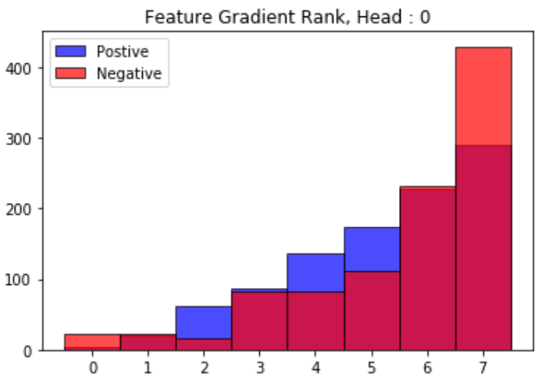
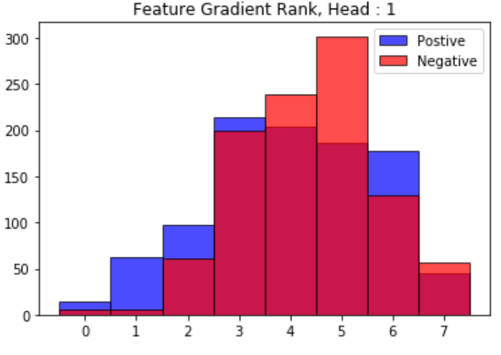
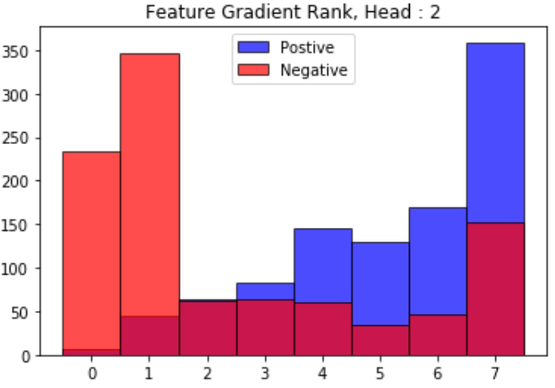
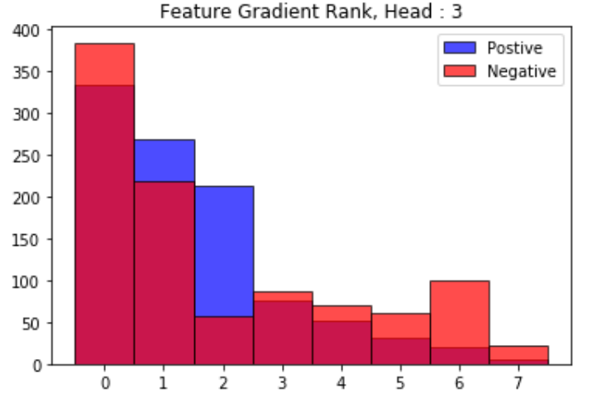
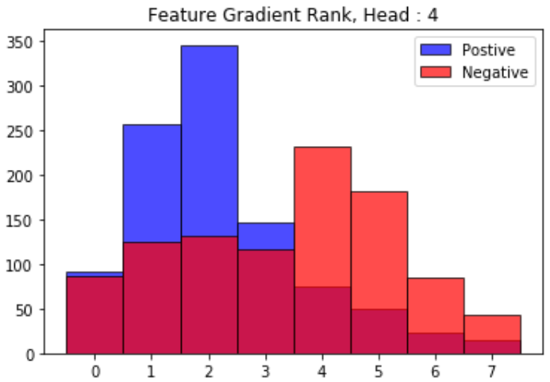
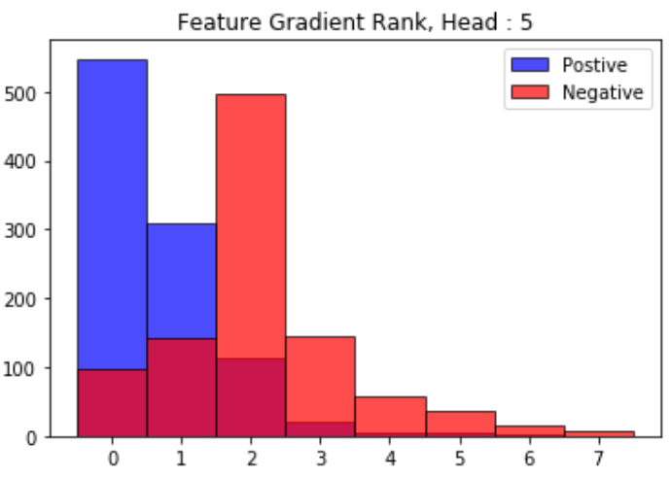
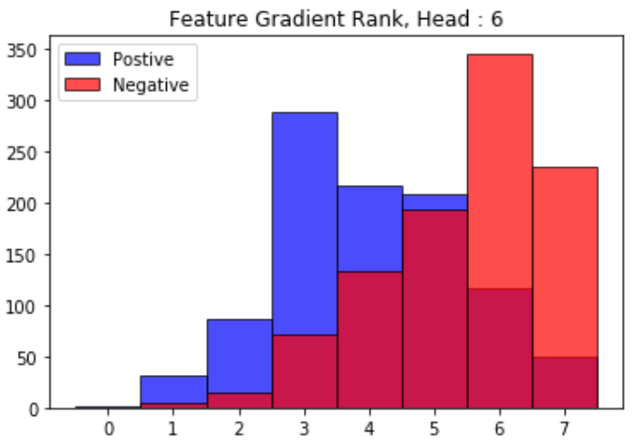
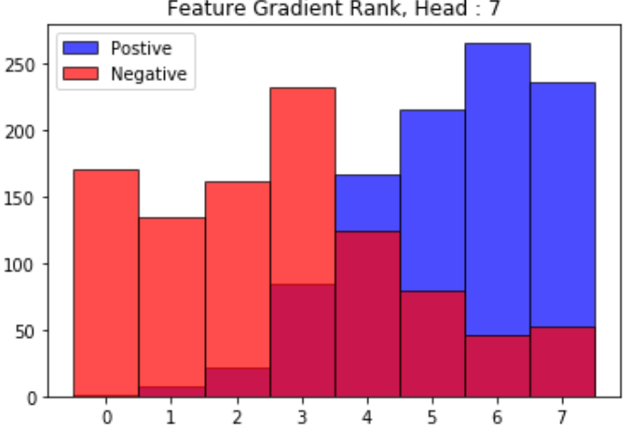
3. Results & Discussion
Attention Analysis
How to identify the important attention head among multiple heads?
Gradient information could help to find the important head!
Head 3 is enriched for both groups.
Head 4 & 5 are more enriched for positive predictions.
Head 2 & 7 are more enriched for negative predictions.
Notes:
Second result is attention analysis.
I drew the histogram of ranks of each head in both groups. As you see,
Head 3 is enriched for both groups,
Head 4 & 5 are more enriched for positive predictions,
Head 2 & 7 are more enriched for negative predictions.

Slide 158
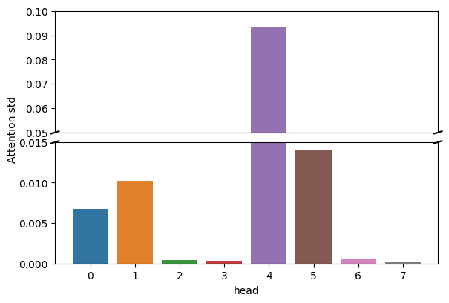
3. Results & Discussion
Attention Analysis
How to identify the important attention head among multiple heads?
Gradient information could help to find the important head!
Head 3 is enriched for both groups.
Head 4 & 5 are more enriched for positive predictions.
Head 2 & 7 are more enriched for negative predictions.
Attention STD of each head
Notes:
As I mentioned last time, attention coefficients in 2, 3, 6, 7 are uniformly distributed.
Interestingly, significantly varied heads (4, 5) are more enriched for positive predictions and non-significantly varied heads are more enriched for negative predictions.
However, head 3 is enriched for both groups, which is a bit weird situation.

Slide 159
Future works
Notes:
So now I will end up my presentation with future works.

Slide 160
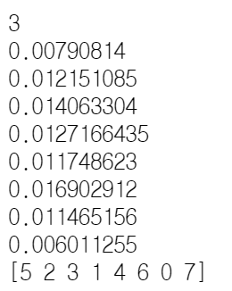
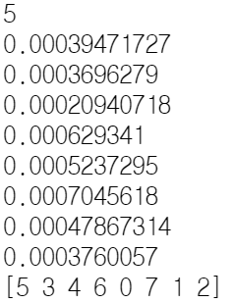
4. Future works
Future works
Use integrated gradient for calculating head importance.
Attention case study – after integrated gradient.
Figure organizing & Writing.
Notes:
For the future works, I will use integrated gradient for calculating head importance.
As you see below, if the prediction is extremely high or low, the attribution is also low, and the ranking among this small number is meaning less.
I think it is because of the limitation of just simple gradient. Maybe integrated gradient would help this situation.
Second, I will conduct case study of attention with the gradient attribution information. I don’t have any detail plan but maybe activity cliff data could be employed.
Third, I will prepare figures and organize them to write the paper and start to write the manuscript.

Slide 161
Thank You
Notes:
This is end of my presentation. Thank you.

Slide 162
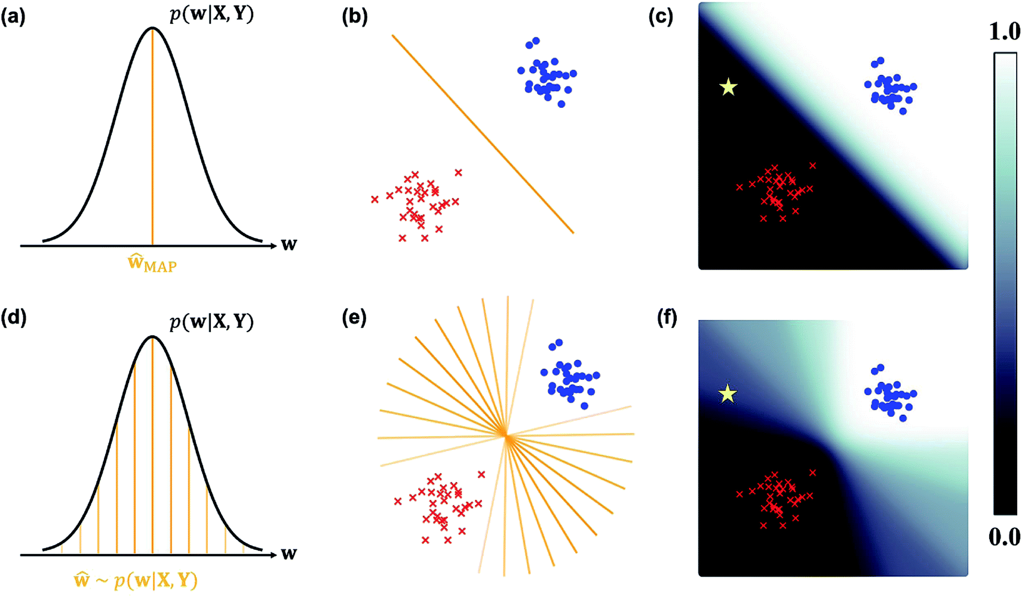
Appendix
Prerequisites
Bayesian inference basic
Conventional Deep neural network models are obtained by point-estimation-based methods such as MAP(maximum-a-posteriori) or MLE (Maximum Likelihood Estimation)
Why don’t we directly learn the distribution of w itself?
Notes:
Before explaining my methods, I will briefly introduce the basic of bayesian inference.
Conventional deep neural network models are obtained by point-estimation-based methods such as MAP, MLS.
Then, Why don’t we directly learn the distribution of w itself?

Slide 163
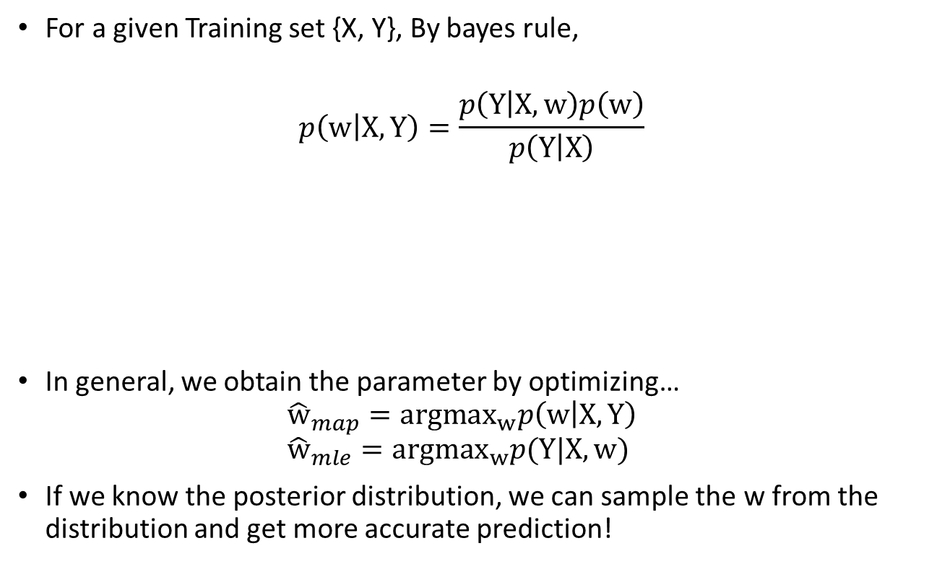
Appendix
Prerequisites
Bayesian inference basic
For a given Training set {X, Y}, By bayes rule,
$$p\left(w | X, Y\right)=\frac{p\left(Y | X, w\right)p\left(w\right)}{p\left(Y | X\right)}$$
In general, we obtain the parameter by optimizing… ${\hat{w}}_{map}={argmax}_{w}p\left(w | X, Y\right)$ ${\hat{w}}_{mle}={argmax}_{w}p(Y|X, w)$
If we know the posterior distribution, we can sample the w from the distribution and get more accurate prediction!
prior
posterior
likelihood
Notes:
The distribution of weight give the data is decomposed into two part, Likelihood and prior by bayes rule.
In general, we obtain the parameter by optimizaing posterior itself or likelihood.
However, they are all point estimation, but if we get the posterior distribution, we can sample the W from the distribution and get more accurate and reliable result!

Slide 164

Appendix
Prerequisites
Bayesian inference basic
However, even though we know the posterior distribution, it is intractable to get the exact conditional probability.
Therefore, Variational Inference method is used to approximate the posterior distribution with tractable and parametrized distributions.
Dropout as Bayesian approximation (MonteCarlo-Dropout, Yarin Gal 2015)
Parameterize the posterior with Bernoulli random variable (Dropout)
Monte-Carlo approximation of conditional probability.
How to use?
Apply dropout to every linear layer in NNs.
Train the NNs.
Keep turning on the dropout at inference stage and sample the results.
Get average and variance of the results. Average : prediction, Variance : uncertainty.
$$p\left(y^{∗} | x^{∗}, X, Y\right)=\int_{w}{p\left(y^{∗}\right|x^{∗},w)p\left(w | X, Y\right)dw}$$
Intractable!
Notes:
However, even though we know the posterior distribution, it is intractable to get the exact conditional probability. Therefore variational inference method is used to approximate the posterior distribution with tractable and parametrized distributions.
A clever and famous guy proposed and proved that the dropout could be used to bayesian approximation.
First, he parametrize the posterior with Bernoulli random variable, and conduct the monte-carlo approximation to approximate the integration.
Pratically, it is really easy to use in every NNs.
First, apply the dropout to every linear layers in NNs.
Second train the NNs with desired loss or calibrated loss.
In the inference stage, just keep turning on the dropout and sample the results.
Then finally, Get the average and variance of the results.

Slide 165

Appendix
Prerequisites
Uncertainty of Bayesian Deep Learning
The uncertainty of the prediction $Var\left[y | x\right]$ is consist of two uncertainties in BNN:
$$Var\left[y_{i} | x_{i}\right]=\frac{1}{T}\sum_{t=1}^{T}{{\left(y_{i}^{t}−{\overline{y}}_{i}\right)}^{2}+\frac{1}{T}\sum_{t=1}^{T}{{\left(σ_{i}^{t}\right)}^{2}}}$$
By Kwon et al*’s derivation, the uncertainty of the classification in BNN can be estimated as:
$$\hat{Var_{p}}\left[y^{∗} | x^{∗}\right]=\frac{1}{T}\sum_{t=1}^{T}{\left({\hat{y}}_{t}^{∗}−\overline{y}\right){\left({\hat{y}}_{t}^{∗}−\overline{y}\right)}^{T}}+\frac{1}{T}\sum_{t=1}^{T}{(diag\left({\hat{y}}_{t}^{∗}\right)−\left({\hat{y}}_{t}^{∗}\right){\left({\hat{y}}_{t}^{∗}\right)}^{T})}$$
Epistemic
Aleatoric
Due to the insufficient data (From model parameter variance)
Due to the data inherent noise
(From data.. We don’t know)
epistemic
aleatoric
*https://stat.snu.ac.kr/mcp/Uncertainty.pdf
Notes:
The real uncertainty of prediction is consist of two uncertainties.
Epistemic and Aleatoric.
The epistemic uncertainty is due to the insufficient data and it comes from the model variance.
The aleatoric uncertainty is due to the data inherent noise , so actually, we cannot know.
In BNN framework, the epistemic and aleatoric uncertainties are estimated by monte-carlo approximation.
So First, we sample the response and corresponding heteroscedastic variance from the models sampled from posterior. And average them to get the approximation.
But in the case of classification, the story is a bit different. Because, the distribution of samples is binomial or multinomial distribution, and their variance is depends on the class probability parameters.
Thus, in the recent study of kwon et al, they derived how to estimate epistemic and aleatoric uncertainty of classification in BNNs.
It is quite intuitive.
The epistemic uncertainty is the variance of the sampled models’ predictions. And the aleatoric uncertainty is the mean value of variance of multinomial distribution with sampled parameters y hat.

Slide 166



Appendix
Uncertainty modeling methods
There are two way to model the classification uncertainty in Bayesian Neural Network.
Implicit : Train the BNN(MC-dropout) ordinarily to predict the probability. Nothing reflected in loss(CE).
Explicit : Train the BNN(MC-dropout) to predict both the probability and logit-space aleatoric uncertainty. The aleatoric uncertainty in logit-space attenuate the loss function.
Assume that the predicted logit and probability is :
$${\hat{x}}_{i}|W\sim 𝒩\left(f_{i}^{W}, {\left(σ_{i}^{W}\right)}^{2}I\right)$$
$${\hat{p}}_{i}=Softmax({\hat{x}}_{i})$$
Therefore, the expected likelihood is :
$𝔼_{𝒩\left(f_{i}^{W}, {\left(σ_{i}^{W}\right)}^{2}I\right)}\left[{\hat{p}}_{i,c}\right]$
In practice, the expected likelihood is approximated by Monte-Carlo approximation,
${\hat{x}}_{i,t}=f_{i}^{W}+σ_{i}^{W}ε_{t}, ε_{t}\sim 𝒩(0, I)$
${\hat{p}}_{i}=\frac{1}{T}\sum_{t}{Softmax({\hat{x}}_{i, t})}$
Uncertainty
Uncertainty of Bayesian Deep Learning
Model
$$f_{i}$$
$$σ_{i}^{2}$$
Aleatoric unc. in logit space
Notes:
There are two major way to model the classification uncertainty in BNNs.
First one is implicit way.
It is proposed in Kwon et al as I mentioned in last slide.
First, train the MC-dropout-based BNNs ordinarily only to predict the class probability.
After training, just sample the predicted class probability with test-time dropout, and estimate the epistemic uncertainty and aleatoric uncertainty with the derived formula.
The predicted uncertainty is not reflected in the loss function, therefore I called it implicit model.
Second one is explicit way.
It is proposed by Kendal et al in 2017. They focused on regressing the logit value before softmax squashing. They assumed that the predicted logit value is following the Gaussian distribution with mean logit prediction and predicted logit space variance.
So they proposed the MC-dropout-based BNNs that predicts both the probability and logit-space aleatoric uncertainty.
To train the proposed BNNs, the expected likelihood is needed. However, it is computationally intractable therefore, also the monte-carlo approximation is used in practice.
First the predicted logit is corrupted with sampled noise scaled by predicted aleatoric uncertainty T times. Each T corrupted logits are squashed by softmax function, and finally, the predicted class probabilities are acquired by taking an average of them.
In conclusion, the aleatoric uncertainty attenuate the loss by adding the noise. therefore I called it explicit model.
Actually, they don’t suggest how to estimate the uncertainties. So here, I decided to use the same way to estimate the uncertainty which is proposed in Kwon et al. The difference is whether the loss is attenuated or not.

Slide 167












Appendix
Model Overview
Implicit Model
Explicit Model
5
5
2
2
4
1
4
1
3
3
DMPNN*
DMPNN*
DMPNN*
DMPNN*
DMPNN*
DMPNN*
(Kwon et al 2020)
(Kendal et al 2017)
GMHAP**
GMHAP**
GMHAP**
GMHAP**
GMHAP**
GMHAP**
FC-ReLU
FC-ReLU
FC-ReLU
FC-ReLU
FC
FC
FC-ReLU
FC
FC
FC-ReLU
FC
FC
$$\hat{l}$$
$$log {\hat{σ}}^{2}$$
$$\hat{l}$$
$$log {\hat{σ}}^{2}$$
FC
$$\hat{l}$$
$$log {\hat{σ}}^{2}$$
FC
FC
Softmax
Softmax
T times
Softmax
Softmax
Softmax
T times
Softmax
T times
Softmax
Softmax
Softmax
Softmax
Softmax
Softmax
Average
$$\hat{y}$$
Average
$$\hat{y}$$
Average
$$\hat{y}$$
$$\hat{y}$$
$$\hat{y}$$
*DMPNN : Directed MPNN
**GMHAP : Global Multi-head attention Pooling
$$\hat{y}$$
Notes:
There is no study which compares the both methods.
Thus, in my study, I constructed both models and tried to catch the difference of them.
Therefore, in my case, the first one is implicit and the other is explicit model.
Former model only predicts the predicted score n-times by test-time dropout and used to estimate the calibrated probability and uncertainties.
Later model first predicts the mean and log variance of the logit distribution. Then, It conducts softmax squashing after corrupting the logit with sampled scaled noise T times.
After the corruption and sqashing, the mean of the T time sampled likelihoods is used to predict.
Like before, the model predicts the predicted score like this way for n-times by test-time dropout and used to estimate the calibrated probability and uncertainties.

Slide 168





Appendix
DMPNN
Message Passing
$$m_{vw}^{t+1}= {\sum_{k∈\{N(v)∖w\}}{h_{kv}^{t}}}_{}^{}$$
Update
$$h_{vw}^{t+1}=ReLU\left(h_{vw}^{0}+W_{m}m_{vw}^{t+1}\right)$$
$$h_{vw}^{0}=ReLU(W_{i}[{x_{v}^{},e}_{vw}])$$
After T iterations of (1-2)…
$$m_{v}=\sum_{w∈N\left(v\right)}{h_{vw}^{T}}$$
$$h_{v}=ReLU(W_{a}\left[x_{v}, m_{v}\right])$$
$$h_{32}^{(t+1)}$$
$$h_{53}^{(t)}$$
$$h_{43}^{(t)}$$
Thx to haelee
Notes:
This is the featurizer module that I employed. Called Directed Message Passing neural network.
As I explained this last meeting and due to the time constraints, I will skip the detail algorithms of DMPNN and Global multi head pooling.
If you are curious about this algorithm, please ask me in QnA time.
Unlike other graph convolutional neural networks, this works with an edge updating scheme.
First, whole undirected edges are converted into bi-directional edges.
In message passing step, the message of outgoing edge is cumulated with the other ingoing edges.
Then the new edge feature is updated by simple FC layer with the cumulated message and initial features.
For example, the edge feature h32 at time step t+1 is generated by aggregating the ingoing edge features except h23.
After T iteration of Message passing and update step, All incoming edge features are gathered to make node messages.
The final node features are generated by simple FC layer with node messages and initial node features.

Slide 169





Appendix
Global multi-head-attention pooling
Idea : Use super node which are connected to all nodes to pool the graph. (To get the global attention)
Multi-head-attention and Compound token vector used to global graph pooling.
Node 1
Node 2
$$×$$
$$=$$
Because…
1. Permutation-invariant.
2. Helps to learn data-specific pooling by the self-attention mechanism.
3. Gives the interpretability to the model.
Node 3
Node 1
Node 2
Compound token
Node 3
Compound token
Super node
Attention Matrix
Node 1
Node 1
$$×$$
Node 2
$$=$$
Node 2
Node 3
Node 3
Compound token
Compound token
Attention Matrix
Used to predict!
doi: 10.1021/acs.jmedchem.9b00959.
Notes:
This is the pooling module that I used. I will call this global multi-head attention pooling module.
Also I will skip the detail algorithms. Please ask me in QnA time if you want to know the detail.
As you already know, the final node features should be pooled in order to make graph representation vector.
This kind of graph pooling is called readout function. In this study, I employed the multi-head attention method to pool the graph.
For example, after node updating, the compound token vector is appended and works as super node of the graph.
Then simple multi-head self-attention is conducted and the final updated token vector is used to predict the desired output.
The reason why I employed this mechanism is because…
First, this method is permutation-invariant.
Second, It pushes the model to learn data-specific pooling by the self-attention mechanism.
Third, It can gives the interpretability to the model.

Slide 170

Appendix
Dataset (preprocessed)
Pre-training set – hERG inhibition percentage (%) at 10uM - Regression
Source | # of Data
MLSMR | 304,045
Scaffold Data Split (9:1)
Used for pretraining!
Fine-tuning set – hERG Blocker (IC50 $≤$ 10uM)
Source | Positive | Negative | # of Data
ChEMBL, PubChem, BindingDB, Cai et al | 8,488 | 5,834 | 14,322
Scaffold Data Split (8:1:1)
MLSMR : Molecular Libraries Small Molecule Repository.
Notes:
I used MLSMR data as a pretraining data because there are sufficient amount of data but it has label of hERG inhibition percentage, not IC50.
After pretraining, I fine-tuned the model with IC50-based labeled dataset collected from publicly available data.
Although both data have generated for different tasks, I think the transferability of pretraining data is quite promising because their tasks are quite similar.
I conducted random split to the pretraining set into training and validation because it have enough data.
But in fine-tuning task, I conducted scaffold split to evaluate the models’ generalization power.

Slide 171
Appendix
Calibration analysis
Evaluate whether the model is well-calibrated or not.
Calibrated ➔ the predicted score is proportional to the probability.
bins
Mean score
0.1 | 0.2 | … | 0.9
Positive ratio
0.2 | 0.2 | … | 0.7
Positive ratio
1.0
AUCE = Area under calibration-error curve
= Sum of calibration error
ECE = Expected calibration error
= Mean of calibration error
MCE = Maximum calibration error
0.7
AUCE
MCE
0.2
ECE = AUCE / nbins
0.1
0.2
0.5
0.9
1.0
Mean score
Notes:
To evaluate whether the model is well-calibrated or not, the calibration analysis is required.
The word “Calibrated” means that the predicted score is proportional to the class probability.
For example in the test set, we can get the true positive ratio at the corresponding score bins. So we can draw the line graph with positive ratio and mean score.
If the model is perfectly calibrated, the line graph should be dashed-diagonal line.
otherwise, we can get the area between the dashed-line and the generated line graph.
So the metric called AUCE stands for area under calibration-error curve which is the sum of calibration error.
And the other metric called MCE stands for maximum calibration error which is the maximum value among the errors.
So we can easily understand that lower AUCE is better and lower MCE is more stable at calibration respectively.

Slide 172


Appendix
Calibration result
Non-transferred models

Slide 173


Appendix
Calibration result
Transferred models

Slide 174
Appendix
Initial feature for DMPNN
Atom Feature | Feature Length
Atom Type | 43
Atom Degree | 11
Number of implicit Hs | 7
Formal Charge | 1
Number of radical electrons | 1
Atom hybridization | 5
Aromatic | 1
Number of total Hs | 5
Total | 74
Bond Feature | Feature Length
Bond type | 4
Conjugated bond | 1
Is in a ring | 1
Stereo configuration | 6
Total | 12
Notes:
Before start message passing, I initialized the node and edge feature of the graph. In the chemical, the atoms are regarded as nodes, and the bonds are regarded as edges. For the node feature, I initialized with these kinds of atom features which are conventional. Also Edge features are initialized with these kinds of features , and they are also conventional.

Slide 175
Appendix
Internal test models (Scaffold splitting)
MLP (1024-128-25-1) (ECFP)
RF (ECFP)
DMPNN
DMPNN + GMHAP
(4) + MC-dropout + Explicit modelling
(4) + MC-dropout + Implicit modelling
(3) + Transfer learning
(4) + Transfer learning
(5) + Transfer learning
(6) + Transfer learning
Non-Bayesian
+Bayesian
+Transfer
+Bayesian + Transfer
Notes:
I compared 10 different models
Model 1 and 2 are the conventional machine learning models.
3 and 4 are graph neural networks model with DMPNN, but the Global multi-head attention pooling is plugged in the model 4.
5 and 6 are the bayesian model of model number 4. one is the explicit model and the other is implicit model.
7 and 8 are the transferred model of model number 3 and 4 by pretraining and fine-tuning.
9 and 10 are the transferred model of model number 5 and 6.

Slide 176



Appendix
Pre-training result
Pre-training performance (Test set)
All models showed the similar prediction power on the pre-training task test set.
However, the overall performance is not up to par.
(Mean absolute Error = 11%)
Model | MAE | R2 | Pearson R
DMPNN | 0.117 | 0.384 | 0.631
DMPNN+GMHAP | 0.114 | 0.414 | 0.655
BDPMNN+GMHAP | 0.115 | 0.405 | 0.645
DMPNN
DMPNN_GMHAP
BDMPNN+GMHAP
Notes:
First is calibration results. In non-transferred cases, the calibration of Bayesian models are better than others.
Also the calibration qualities was better in Explicit model in test set.

Slide 177

Appendix
Performance Evaluation (General)
Conventional methods showed similar or better performance to GNN models w/o transfer learning.
Transfer learning are effective in increasing performance.
MC-dropout and GMHAP make the model works better.
Notes:
This is the performance comparison result in scaffold validation and scaffold test set.

Slide 178

Appendix
Performance Evaluation (Hard)
Conventional methods are weak at non-similar samples (Memorization).
Proposed Bayesian models outperforms among all comparative models.
Notes:
This is the performance comparison result in scaffold validation and scaffold test set.

Slide 179
Appendix
Calibration result
In Transferred cases, the calibration of Bayesian + GMHAP models are better than others.
Implicit model’s calibration quality is quite similar to the quality of explicit model. (Not significant)
Calibration error is rather increased after pretraining.
ECE (Expected Calibration Error)
Model → | DMPNN | DMPNN_GMHAP | Bayes_DMPNN_GMHAP
Dataset ↓ |  |  | Explicit | Implicit
Sca Test | 0.0673 | 0.0599 | 0.0384 | 0.0372
Sca Test (Hard) | 0.0802 | 0.0727 | 0.0697 | 0.0602
Non transfer Diff
+0.0073
+0.0166
MCE (Maximum Calibration Error)
Model → | DMPNN | DMPNN_GMHAP | Bayes_DMPNN_GMHAP
Dataset ↓ |  |  | Explicit | Implicit
Sca Test | 0.1263 | 0.1427 | 0.0874 | 0.0827
Sca Test (Hard) | 0.1777 | 0.1724 | 0.2217 | 0.1663
Good starting point doesn’t need the loss attenuation (regularization).
Pretraining makes model be more confident.
Notes:
In transferred cases, of course, the calibration of Bayesian was better than others.
But in transferred case, the implicit model’s calibration quality was slightly better than explicit model. However, it was not that significant.
So I concluded that loss attenuation works well when the model was not pretrained. And Good starting point dosen’t need the loss attenuation.

Slide 180
Appendix
Calibration result
In Non-transferred cases, the calibration of Bayesian + GMHAP models are better than others.
Calibration qualities was better in Explicit model in Test set.
ECE (Expected Calibration Error)
Model → | DMPNN | DMPNN_GMHAP | Bayes_DMPNN_GMHAP
Dataset ↓ |  |  | Explicit | Implicit
Sca Test | 0.0736 | 0.0541 | 0.0299 | 0.0361
Sca Test (Hard) | 0.0766 | 0.0748 | 0.0436 | 0.0628
MCE (Maximum Calibration Error)
Model → | DMPNN | DMPNN_GMHAP | Bayes_DMPNN_GMHAP
Dataset ↓ |  |  | Explicit | Implicit
Sca Test | 0.1419 | 0.1327 | 0.0737 | 0.0829
Sca Test (Hard) | 0.2073 | 0.1622 | 0.1009 | 0.1317
Loss attenuation works well when the model was not pretrained.
Notes:
First is calibration results. In non-transferred cases, the calibration of Bayesian models are better than others.
Also the calibration qualities was better in Explicit model in test set.

Slide 181


Appendix
EEE
Uncertainty analysis
Epistemic uncertainty is related to model incompleteness, and it is due to insufficient data.
Q) What is the aleatoric uncertainty in binary classification?
A) The variance of the data label sampled from binomial i.i.d. Thus the true aleatoric uncertainty is determined by individual binomial parameter p. Theoretically, we can estimate the aleatoric uncertainty with predicted probability p in any classification models. (Epistemic = 0, Aleatoric = p(1-p))
In our study, the binomial parameter p is determined by IC50 variance and user-defined threshold.
As the IC50 variance is unknown and unable to estimate with classification model, the aleatoric uncertainty should be generally high if the IC50 is near the threshold!
Scaffold Test
Epistemic
Aleatoric
Unc.
probability
probability
Q) Does the model capture the IC50 threshold as a classification boundary? (Are the estimated aleatoric uncertainty high at IC50 threshold?)
Notes:
Ok so now, let’s analyze the estimated uncertainty.
Let’s see the epistemic uncertainty first. the epistemic uncertainty is related to model incompleteness, and it is due to the insufficient data.
It comes directly from the model variance.
So, Let’s see the overall quantified uncertainty result.
As you see, the epistemic uncertainty is significantly lower than aleatoric uncertainty.
It means that the variance of the model parameter distribution is low, that means the BNN is stable to the given data.
So, I am gonna ignore the epistemic uncertainty from now in this study.
Then, What is the aleatoric uncertainty in binary classification???
The true aleatoric uncertainty is the variance of the data labels which were sampled from binomial i.i.d. Thus the aleatoric uncertainty is determined by binomial parameter p.
Theoretically, we can estimate the aleatoric uncertainty with predicted probability p in any classification models. (Var = p(1-p))
In our study, as we manually label the data with IC50 value, the binomial parameter p is determined by IC50 variance and user-defined threshold.
But the IC50 variance is unknown and it is even unable to directly estimate with classification model therefore theoretically, the predicted aleatoric uncertainty should be generally high if the IC50 of the data is near the threshold.
Thus I got a question. The question is..
In other words, in the view of uncertainty,
The estimated aleatoric uncertainty is high at IC50 threshold?
So basically, If the aleatoric uncertainty is high in classiciation, that means the input labels are unreliable.
However the IC50 variance is unknown and unable to estimate with classification model,

Slide 182




Appendix
Uncertainty analysis
pIC50-Alea hex plot (Training set, No transfer learning)
DMPNN
DMPNN+GMHAP
All models showed high aleatoric uncertainty at the approximate pIC50 threshold (4.5~5).
However, unlike Bayesian models, non-bayesian models are over-confident. → Dispersion is low.
Bayesian EXP
Bayesian IMP
Notes:
So this is the hex plot of the training samples’ pIC50 and corresponding estimated aleatoric uncertainty. And these are non-transferred cases.
All models showed generally high aleatoric uncertainty at the approximate pIC50 threshold (4.5~5).
However, unlike bayesian models, non-bayesian models are over-confident. As you see the dispersion of uncertainty is lower than bayesian models.
OK. So will the results change after pre-training?

Slide 183




Appendix
Uncertainty analysis
pIC50-Alea hex plot (Training set, Transfer learning)
DMPNN
DMPNN+GMHAP
After pretraining, all models becomes more confident, but still the non-Bayesian models’ dispersion is lower than Bayesian models.
Interestingly, Bayesian models recognized the strong positive compounds more confidently than non-Bayesian models.
Bayesian EXP
Bayesian IMP
Notes:
After pretraining, all models becomes more confident, but still the non-Bayesian models’ dispersion is lower than Bayesian models.
Interestingly, Bayesian models recognize the strong positive compounds more confidently than non-bayesian models.

Slide 184


Appendix
Uncertainty analysis
Q) How much did the overall uncertainty change through transfer learning?
A)
Epistemic uncertainty was not significantly reduced.
→ No adding more data
Aleatoric uncertainty was significantly reduced.
→Pretraining helps model to recognize the strong positives or strong negatives.
→Does it make model be over-confident?
Scaffold Test
Epistemic Uncertainty
Aleatoric Uncertainty
Explicit
Explicit
Implicit
Implicit
Notes:
As you see before slide, the aleatoric uncertainty was reduced when the model was pretrained in Bayesian cases.
So I want to see how much the estimated uncertainty is changed through the pretraining.
I compared the uncertainty distribution before and after pretraining.
First, In both explicit and implicit cases, the epistemic uncertainty was not significantly reduced.
Second, also in both cases, the aleatoric uncertainty was significantly reduced. As I mentioned before, the aleatoric uncertainty in our study is determined by IC50 value itself.
Thus if the model correctly recognize the hidden relation between IC50 and structure, the overall aleatoric uncertainty will be reduced.
Here, We can say that the pretraining helps model to recognize the strong positives or strong negatives.
However, we can also ask that does it make model be over-confident? Maybe it will.

Slide 185
Appendix
External Test Result
Fine-tuned whole dataset (Not splitted) and evaluated the performance in external test sets.
External set 1 (DeepHIT set) → P:N = 30:14
Model | Precision | Recall | Accuracy | F1
Pred-hERG (2015) | 0.7742 | 0.8 | 0.7045 | 0.7869
DeepHIT (2020) | 0.833 | 0.833 | 0.773 | 0.833
Proposed (Exp) | 0.9000 | 0.9000 | 0.8636 | 0.9000
Proposed (Imp) | 0.9259 | 0.8333 | 0.8409 | 0.8772
Notes:
To do external evaluation, I fine-tuned whole dataset, not splitted.
I updated pred-hERG result, still the proposed model outperformed others in DeepHIT dataset.

Slide 186
Appendix
External Test Result
2. External set 2 (Siramshetty 2020, FDA drugs)
1uM → P:N = 15:161
10uM → P:N = 46:130
1uM | Sen | Spc | BAC
Pred-hERG (2015) | 0.8667 | 0.472 | 0.6694
DeepHIT (2020) | 0.7333 | 0.6481 | 0.6907
Siramshetty(2020) | 0.71 | 0.78 | 0.75
Proposed (Exp) | 0.9333 | 0.6832 | 0.8082
Proposed (Imp) | 0.9333 | 0.7205 | 0.8269
10uM | Sen | Spc | BAC
Pred-Herg (2015) | 0.8043 | 0.5308 | 0.6676
DeepHIT (2020) | 0.6087 | 0.6947 | 0.6517
Siramshetty(2020) | 0.44 | 0.89 | 0.67
Proposed (Exp) | 0.7609 | 0.7692 | 0.7651
Proposed (Imp) | 0.7174 | 0.8 | 0.7587
Notes:
In external set 2, the proposed model outperformed all other models in terms of Balanced accuracy.
In 1uM case, proposed model showed extremely high sensitivity than others.
In 10uM case, proposed model showed the balanced result while other models showed biased result. For example, Pred-hERG showed the best sensitivity, but the specificity is too low.
And the result of siramshetty et al, the specificity is extremely high, but sensitivity is also extremely low.

Slide 187

Appendix
KCB selection
Descriptor selection
Among 115 Rdkit descriptors,,
Conduct MHU test between hERG positive and hERG negative and select the descriptors which p-value is less than 0.05.
Do Elastic-logistic regression and remove the less important descriptors.
Do Random Forest classification and get top 20 descriptors by the variable importance.
50 times repeat (2~3)
Extract the features that are selected 50 times.
Notes:
First is calibration results. In non-transferred cases, the calibration of Bayesian models are better than others.
Also the calibration qualities was better in Explicit model in test set.

